Slide 1


CLOUD COMPUTING & SECURITY ( BIS613D)
MODULE 1
Distributed System Models and Enabling Technologies
Dr. Srividya R
Assoc. Professor, ISE Dept.

Slide 2
CCS Module-1
Scalable Computing Over the Internet
Technologies for Network Based Systems
System Models for Distributed and Cloud Computing
Software Environments for Distributed Systems and Clouds
Performance, Security and Energy Efficiency

Slide 3
1.1 Scalable Computing Over The INTERNET
Large-scale Internet applications have significantly enhanced the quality of life and information services in society today.
Billions of people use the Internet every day.
As a result, supercomputer sites and large data centers must provide high-performance computing services to huge numbers.
Because of this high demand, Linpack Benchmark for high-performance computing (HPC) applications is no longer optimal for measuring performance.
The emergence of cloud computing demands high-throughput computing (HTC) systems built with parallel and distributed computing technologies.
Data centers, storage systems, and high-bandwidth networks have to be upgraded.

Slide 4
CCS
Computer technology has gone through 5 generations of development.
Each generation lasted from 10 to 20 years.
Successive generations are overlapped in about 10 years.
Since 1990, use of both HPC and HTC systems in clusters, grids, or Internet clouds has increased.
These systems are employed by both consumers and high-end web-scale computing and information services.
The general computing trend is to use shared web resources and massive amounts of data over the Internet.

Slide 5
CCS Quiz-1
What is HPC
What is the benchmark used to measure HPC system performance

Slide 6
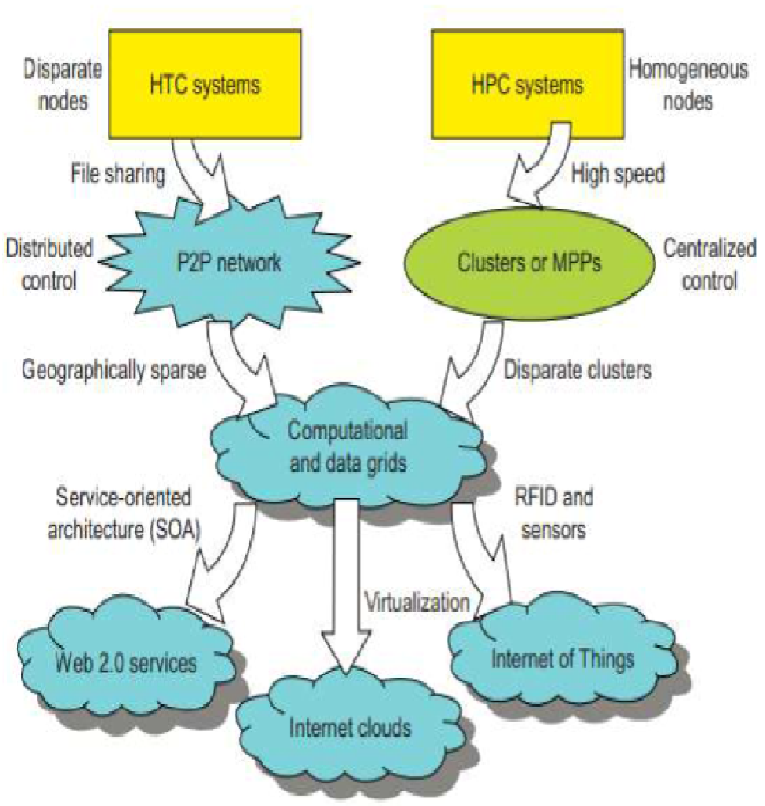

CCS- Evolution of HPC and HTC systems
HPC side:
supercomputers (Massively Parallel Processors) are replaced by clusters of cooperative computers, to share computing resources.
The cluster is collection of homogeneous nodes.
HTC side:
Peer 2 Peer networks are formed for distributed file sharing and content delivery applications.
A P2P system is built over many client machines.
P2P, cloud computing, and web service platforms are more focused on HTC than on HPC applications.
Clustering & P2P technologies lead to development of computational grids or data grids.

Slide 7
HPC-HTC
For many years, HPC systems emphasize the raw speed performance.
The speed of HPC systems has increased from Gflops in the early 1990s to now Pflops in 2010.
The development of high-end computing systems is undergoing strategic change from an HPC paradigm to an HTC paradigm.
The main application for high-flux computing is in Internet searches and web services by millions or more users simultaneously.
The performance goal thus shifts to measure the number of tasks completed per unit of time.
HTC technology needs to improve in terms of:
Batch processing speed.
Address the acute problems of: cost, energy savings, security, and reliability at data centers.

Slide 8
CCS : 3 New Computing Paradigms
The development of the Internet of Things (IoT) is triggered by maturity of:
Radio-frequency identification (RFID),
Global Positioning System (GPS), and
Sensor technologies
Internet was introduced in 1969.
Their were many thoughts shared by many innovators, like:
David Patterson of UC Berkeley said, “The data center is the computer”.
Rajkumar Buyya of Melbourne University simply said: “The cloud is the computer.”

Slide 9
CCS- Computing Paradigm Distinctions
Distributed computing is the opposite of centralized computing.
The field of parallel computing overlaps with distributed computing to a great extent, and
Cloud computing overlaps with distributed, centralized, and parallel computing.
Centralized Computing:
Here all computer resources are centralized in one physical system.
Many data centers and supercomputers are centralized systems.
They are used in parallel, distributed, and cloud computing applications.

Slide 10
CCS
Parallel computing (parallel processing):
Here all processors are either tightly coupled with centralized shared memory or loosely coupled with distributed memory.
Interprocessor communication(IPC) is accomplished through shared memory or via message passing.
A computer capable of parallel computing is commonly known as a parallel computer.
Programs running in a parallel computer are called parallel programs.
The process of writing parallel programs is often referred to as parallel programming

Slide 11
CCS
Distributed computing:
This is a field of computer science/engineering that studies distributed systems.
A distributed system consists of multiple autonomous computers, each having its own private memory, communicating through a computer network.
Information exchange in a distributed system is accomplished through message passing.
A computer program that runs in a distributed system is known as a distributed program.
The process of writing distributed programs is referred to as distributed programming.

Slide 12
CCS
Cloud computing:
An Internet cloud of resources can be either a centralized or a distributed computing system.
The cloud applies parallel or distributed computing, or both.
Clouds can be built with physical or virtualized resources over large data centers that are centralized or distributed.
Some authors consider cloud computing to be a form of utility computing or service
computing
Ubiquitous computing:
Refers to computing with pervasive devices at any place and time using wired or wireless communication.

Slide 13
CCS- Distributed System Families
Computational grids or data grids: wide area computing infrastructures built by P2P networks and networks of clusters.
The largest computational grid connects up to 100’s of server clusters.
A typical P2P network may involve millions of client machines working simultaneously.
Experimental cloud computing clusters have been built with 1000’s of processing nodes.
Future HPC and HTC systems must be able to satisfy huge demand in computing power in terms of :
throughput
efficiency
scalability and
reliability

Slide 14
CCS
Meeting these goals requires to yield following design objectives:
In HPC : Efficiency is determined by Utilization rate of resources in an execution model by massive parallelism.
In HTC: Efficiency is more closely related to job throughput, data access, storage, and power efficiency.
Dependability measures, reliability and self-management, from chip to system & application levels.
To provide high-throughput service with Quality of Service (QoS).
Adaptation in the programming model measures the ability to support billions of job requests over massive data sets and virtualized cloud resources.
Flexibility in application deployment measures the ability to run well in both HPC & HTC applications.

Slide 15
Scalable Computing Trends and New Paradigms
Several predictable trends in technology are known to drive computing applications.
The tremendous price/performance ratio of commodity hardware was driven by the desktop, notebook, and tablet computing markets.
Distributed systems emphasize :
resource distribution and
concurrency or high degree of parallelism (DoP).

Slide 16
CCS- Degree of Parallelism
Bit-level parallelism (BLP): Converts bit-serial processing to word-level processing gradually.
Instruction-level parallelism (ILP): The processor executes multiple instructions simultaneously rather than only one instruction at a time.
Data-level parallelism (DLP): Uses vector or array types of instructions & was made popular through SIMD (single instruction, multiple data) and vector machines.
Task-level parallelism (TLP): It was explored when multicore processors and chip multiprocessors (CMPs) were introduced.
Job-level parallelism (JLP): Moving from parallel processing to distributed processing, there is an increase in computing granularity to job-level parallelism (JLP).
Coarse-grain parallelism is built on top of fine-grain parallelism.

Slide 17
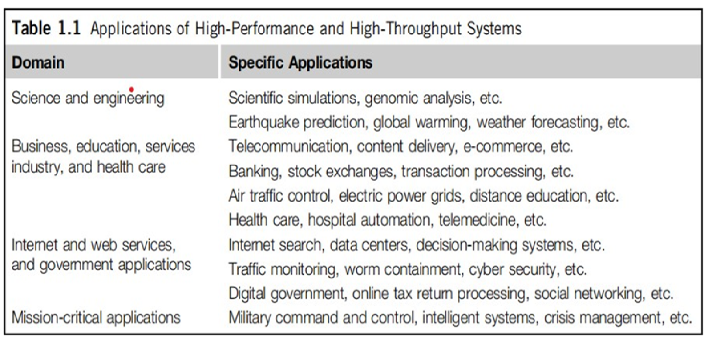
CCS- Innovative Applications
Table highlights few applications that have driven the development of parallel and distributed systems over the years.

Slide 18
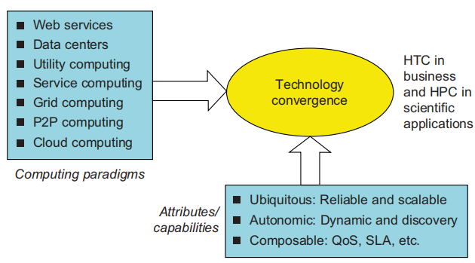
CCS - The Trend toward Utility Computing
Figure shows computing paradigms to help, study, distributed systems & their applications.
These paradigms share some common characteristics.
They are all ubiquitous. Reliability & scalability are 2 major design objectives.
They are aimed at autonomic operations that can be self-organized to support dynamic discovery.
They are composable with QoS and SLAs (service-level agreements).

Slide 19
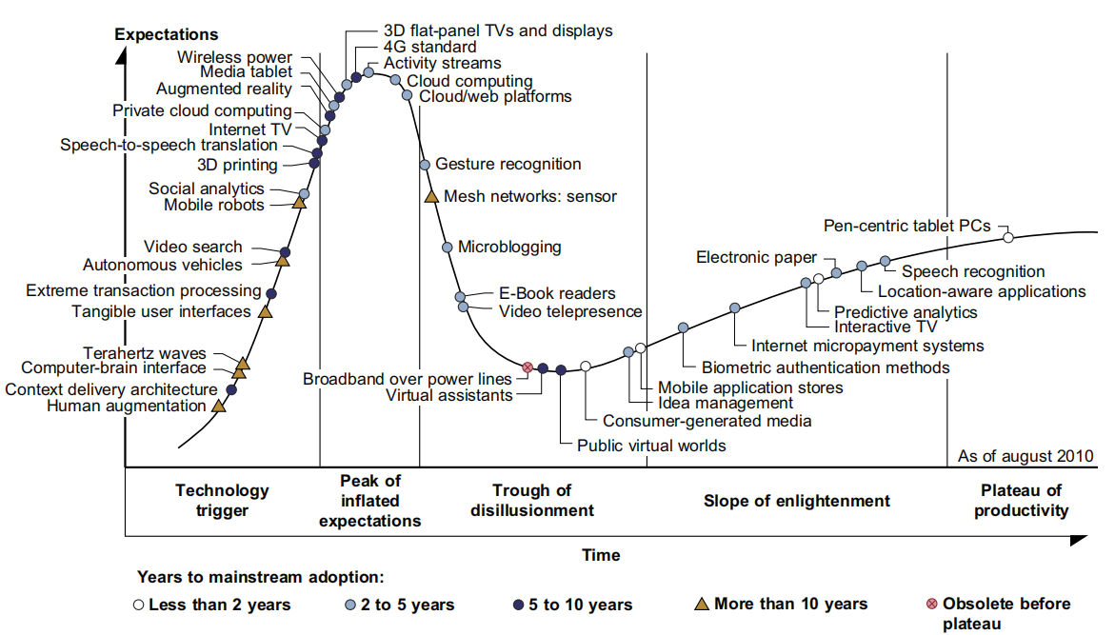
CCS-The Hype Cycle of New Technologies
This cycle shows expectations for technology at 5 different stages, marked by special symbols.
The expectations rise sharply from the trigger period to a high peak of inflated expectations.

Slide 20
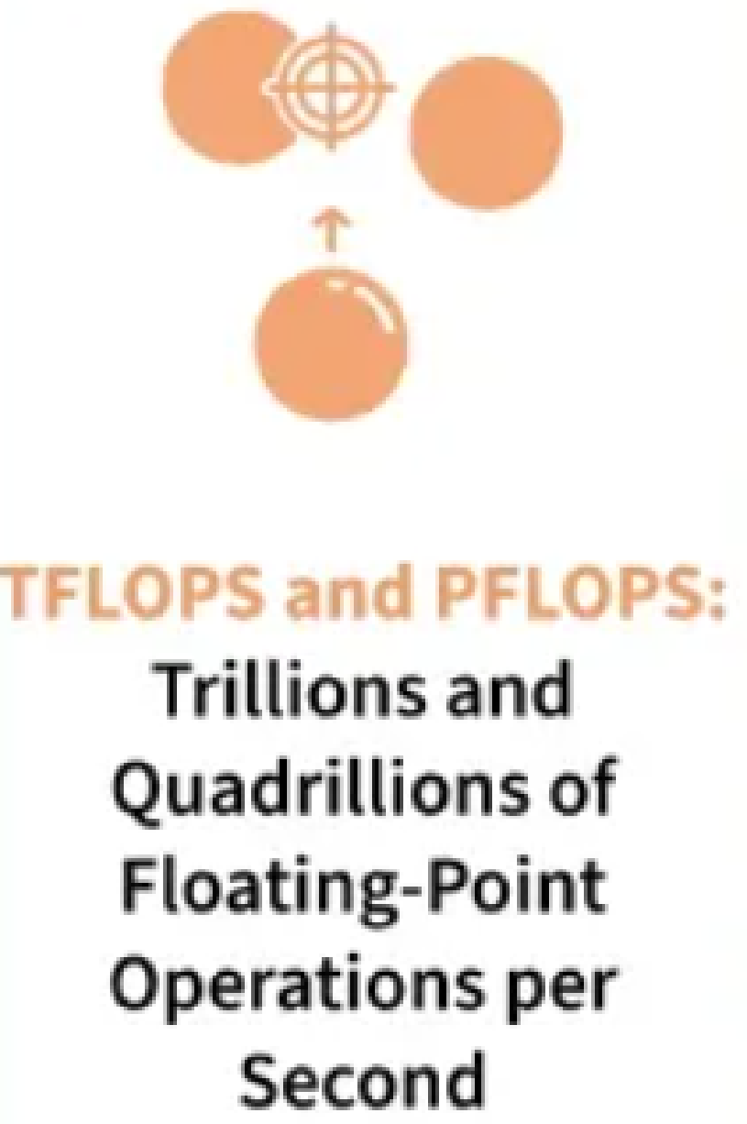

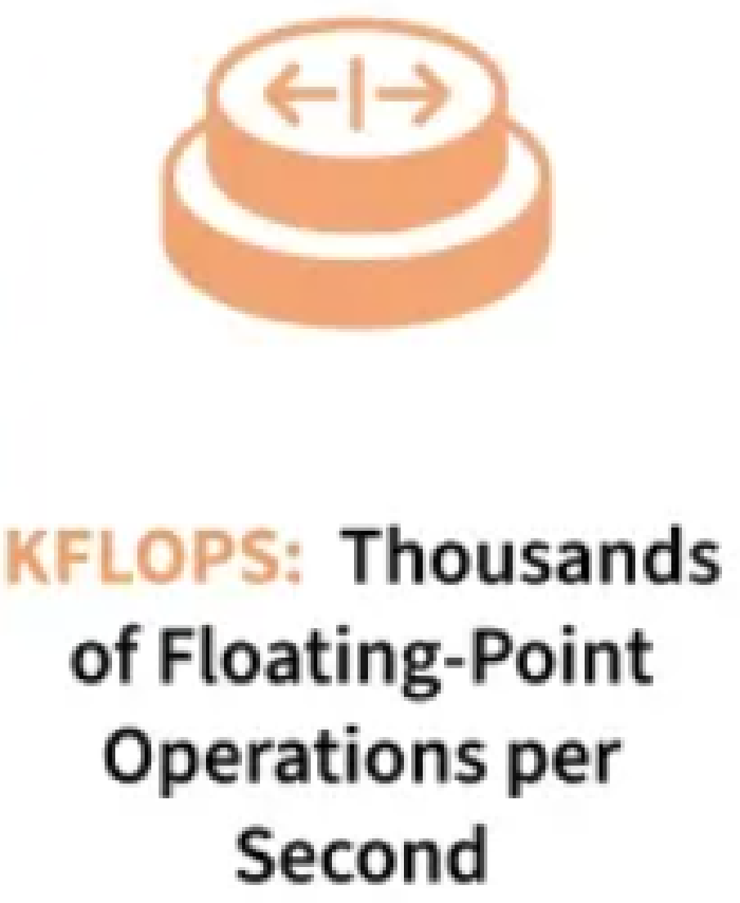
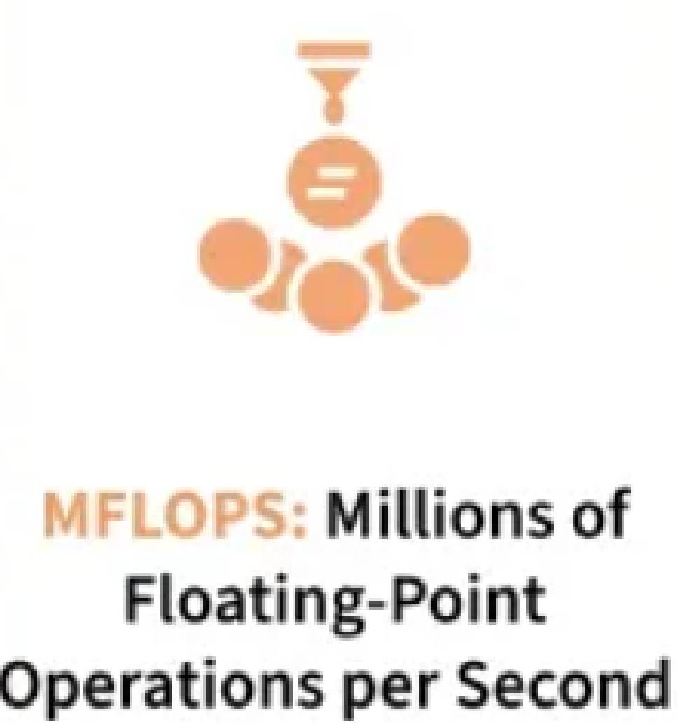
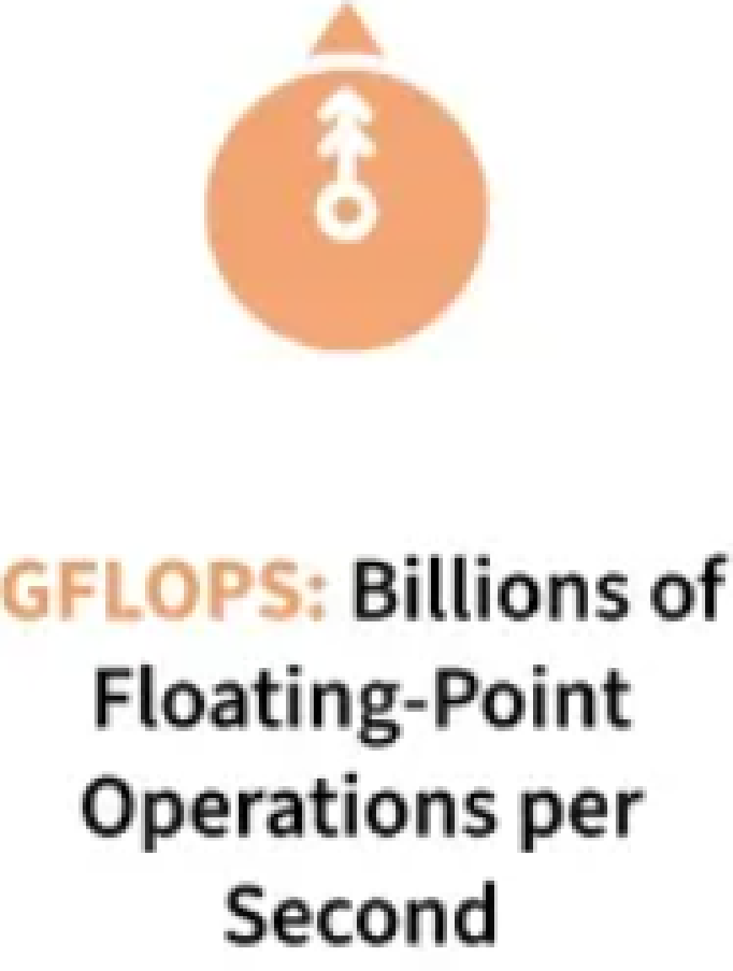
CCS- Recap
HPC and HTC systems
P2P Networks ?
What does Flops mean?

Slide 21
The Internet of Things and Cyber-Physical Systems
IoT refers to interconnection of objects, tools, devices, or computers.
In IoT Network communication can be made between people & things or among things.
3 communication patterns co-exist: namely
H2H (human-to-human),
H2T (human-to_thing), and
T2T (thing-to-thing).
The idea here is to connect things at any time & place intelligently with low cost.
A cyber-physical system (CPS) is the result of interaction between computational processes & physical world.
A CPS integrates “cyber” (heterogeneous, asynchronous) with “physical” (concurrent and information-dense) objects.
CPS merges “3C” technologies of computation, communication & control into an intelligent system between physical & information world.
CPS emphasizes exploration of virtual reality (VR) applications in the physical world.

Slide 22
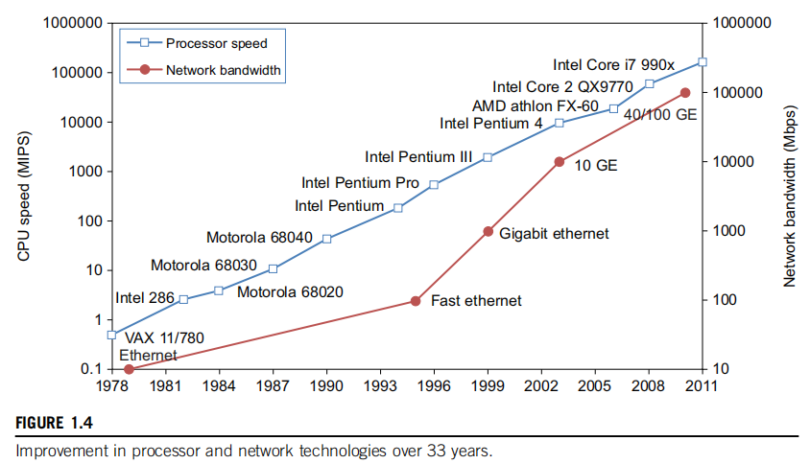
1.2 Technologies for Network Based Systems
In Figure, processor speed is measured in millions of instructions per second (MIPS) and network bandwidth is measured in Mbps or Gbps.
The unit GE refers to 1 Gbps Ethernet bandwidth.

Slide 23
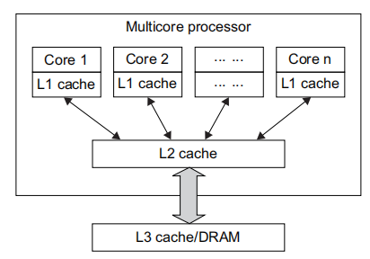
CCS
Figure shows the architecture of a typical multicore processor.
Each core is essentially a processor with its own private cache (L1 cache).
Multiple cores are housed in same chip with an L2 cache that is shared by all cores.
In future, multiple CMPs (Chip multi Processors) could be built on the same CPU chip with even the L3 cache on the chip.
Multicore and multithreaded CPUs are equipped with many high-end processors.

Slide 24
CCS
In 2011, the Intel Core i7 990x has reported 159,000 MIPS execution rate as shown in the uppermost square in Figure.

Slide 25
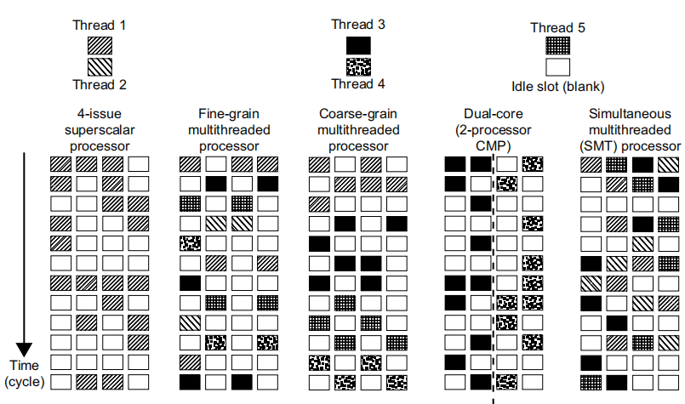
CCS-Multithreading Technology
Now, CPU has reached its limit in terms of massive DLP due to memory wall problem.
Figure depicts:
5 independent threads of instructions
4 pipelined data paths
5 processor categories,
Fig: 5 micro-architectures in modern CPU processors, that exploit ILP and TLP supported by multicore & multithreading technologies.
Instructions from different threads are distinguished by specific shading patterns for instructions from 5 independent threads.
The Blank square corresponds to no available instruction for an instruction data path at particular processor cycle.

Slide 26
CCS
More blank cells imply lower scheduling efficiency.
The point here is to demonstrate understanding of typical instruction scheduling patterns in these 5 different micro-architectures in modern processors.

Slide 27
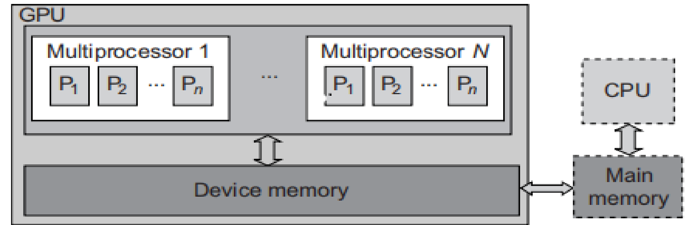
CCS- GPU Computing to Exascale and Beyond
A GPU is a graphics coprocessor or accelerator mounted on a computer’s graphics card or video card.
GPU chips can process a minimum of 10 million polygons per second, & are used in nearly every computer on the market today.
General-purpose computing on GPUs, known as GPGPUs, have appeared in the HPC field.
Figure shows the interaction between a CPU and GPU in performing parallel execution of floating-point operations concurrently.
The CPU is conventional multicore processor with limited parallelism.
The GPU has a many-core architecture that has 100s of processing cores organized as multiprocessors. Each core can have one or more threads.
The CPU instructs GPU to perform massive data processing.
The bandwidth must be matched between the main memory and on-chip GPU memory.
Use of GPU with CPU for massively parallel execution in 100s or 1000s of processing cores.

Slide 28
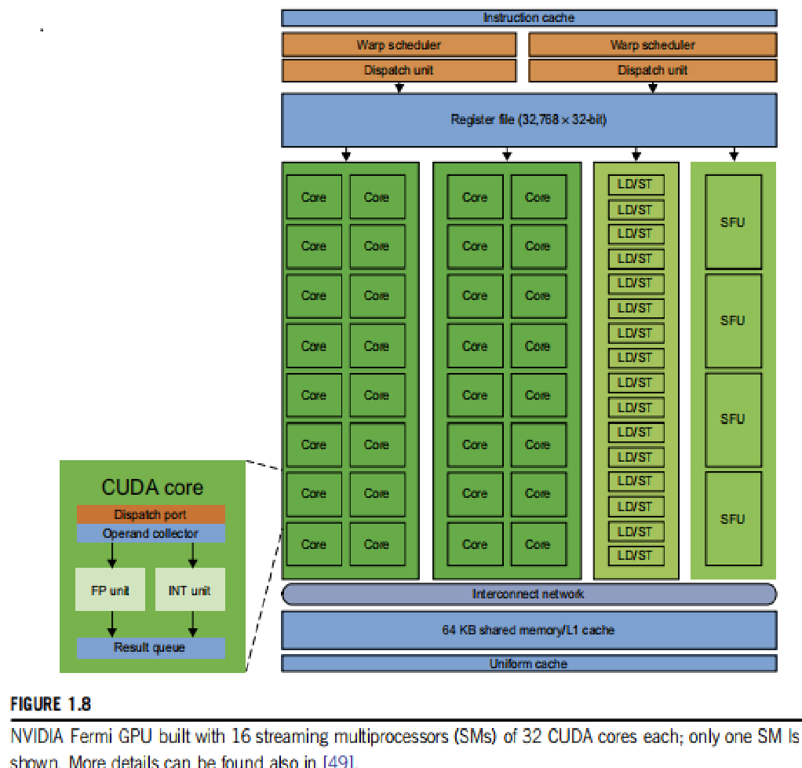
CCS
The NVIDIA Fermi GPU Chip with 512 CUDA Cores
In the future, thousand-core GPUs may appear in Exascale (Eflops or 1018 flops) systems.
This reflects a trend toward building future MPPs with hybrid architectures of both types of processing chips.
4 challenges are identified for exascale computing:
energy and power,
memory and storage,
concurrency and locality,
system resiliency.

Slide 29
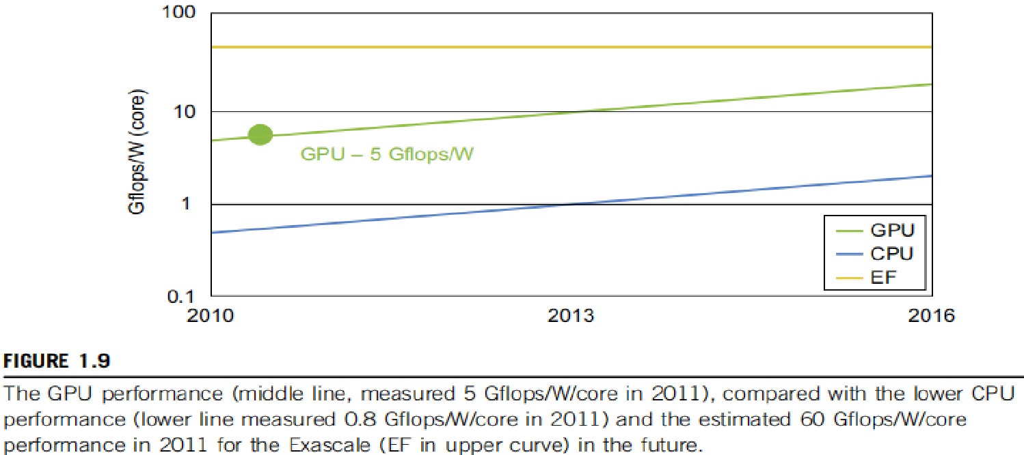
CCS-Power Efficiency of the GPU
Figure compares the CPU and GPU in their performance/power ratio measured in Gflops/ watt per core.
In 2010, the GPU had a value of 5 Gflops/watt at the core level, compared with less than 1 Gflop/watt per CPU core.
This implies:
power and software are real challenges in future computing systems

Slide 30
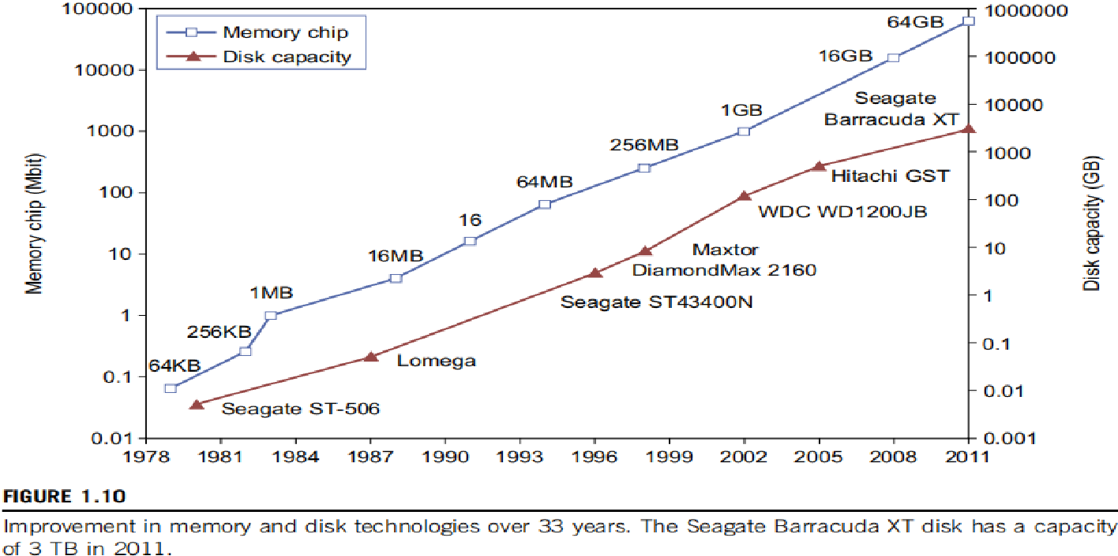
CCS-Memory, Storage, and Wide-Area Networking
The upper curve in Figure plots growth of DRAM chip capacity.
Memory chips have experienced a 4x increase in capacity every 3 years.
For hard drives, capacity increased from 260 MB in 1981 to 3 TB in 2011.
An approximately 10x increase in capacity every 8 years.
Faster processor speed and larger memory capacity result in a wider gap between processors and memory.

Slide 31
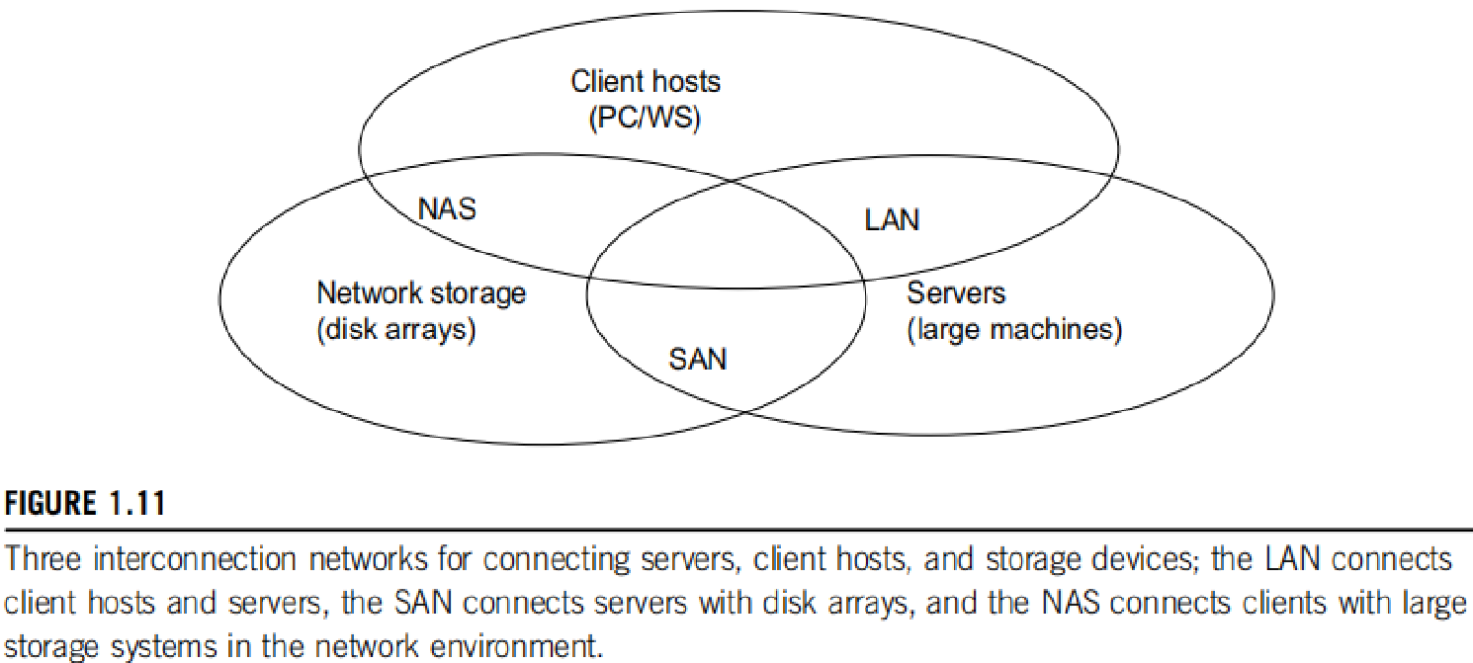
CCS-System-Area Interconnects
As depicted, a LAN typically is used to connect client hosts to big servers.
A storage area network (SAN) connects servers to network storage such as disk arrays.
Network attached storage (NAS) connects client hosts directly to the disk arrays.
All 3 types of networks often appear in a large cluster built with commercial network components.

Slide 32
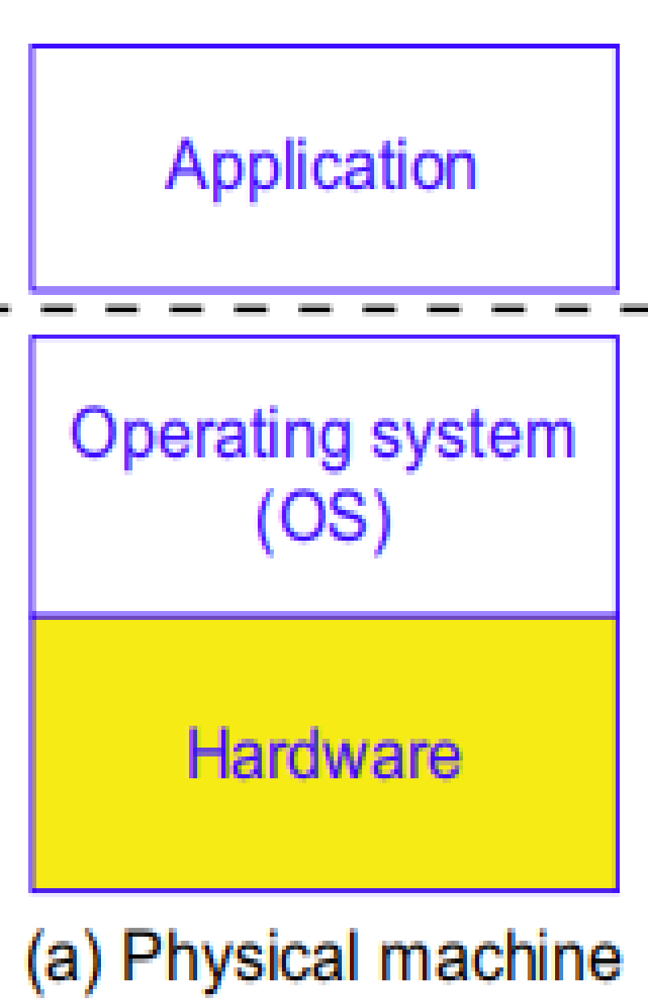
CCS-Virtual Machines and Virtualization Middleware
With fixed OS, some software running well on one machine may not be executable on another platform.
Virtual machines (VMs) offer solutions to:
underutilized resources,
application inflexibility,
software manageability, and
security concerns in existing physical machines.
Figure illustrates the architectures of VM configurations.
a. The host machine is equipped with the physical hardware, as shown at the bottom of the figure.

Slide 33
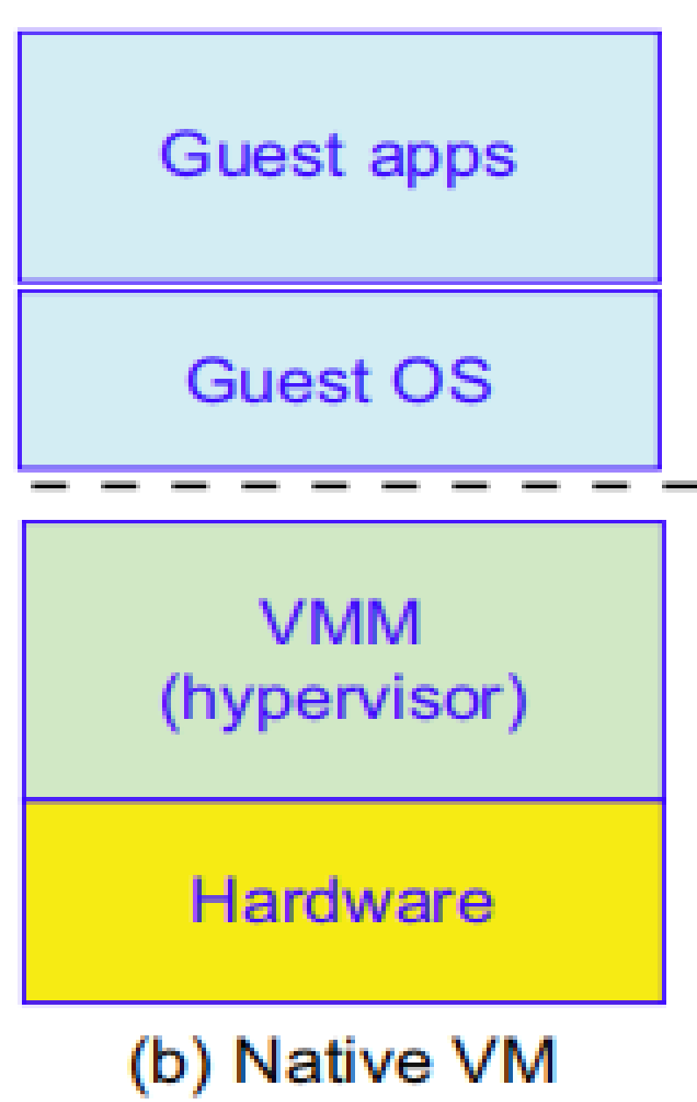
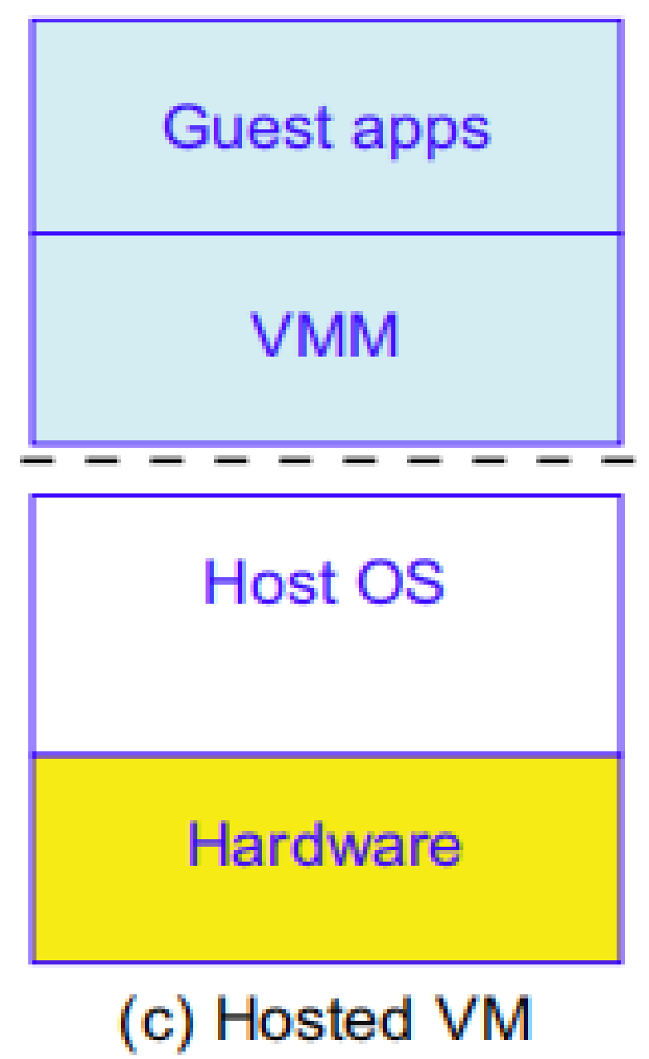

CCS-Virtual Machines and Virtualization Middleware
VM is built with virtual resources managed by a guest OS to run a specific application.
Between the VMs and the host platform, one needs to deploy a middleware layer called a virtual machine monitor (VMM).
Native VM installed with the use of a VMM called a hypervisor in privileged mode.
The guest OS could be a Linux system and the hypervisor is the XEN system.
Hypervisor (or Bare-metal VM) handles bare hardware (CPU, memory, and I/O) directly.
Another architecture is the host VM shown in Figure (c).
Here the VMM runs in nonprivileged mode. The host OS need not be modified.

Slide 34
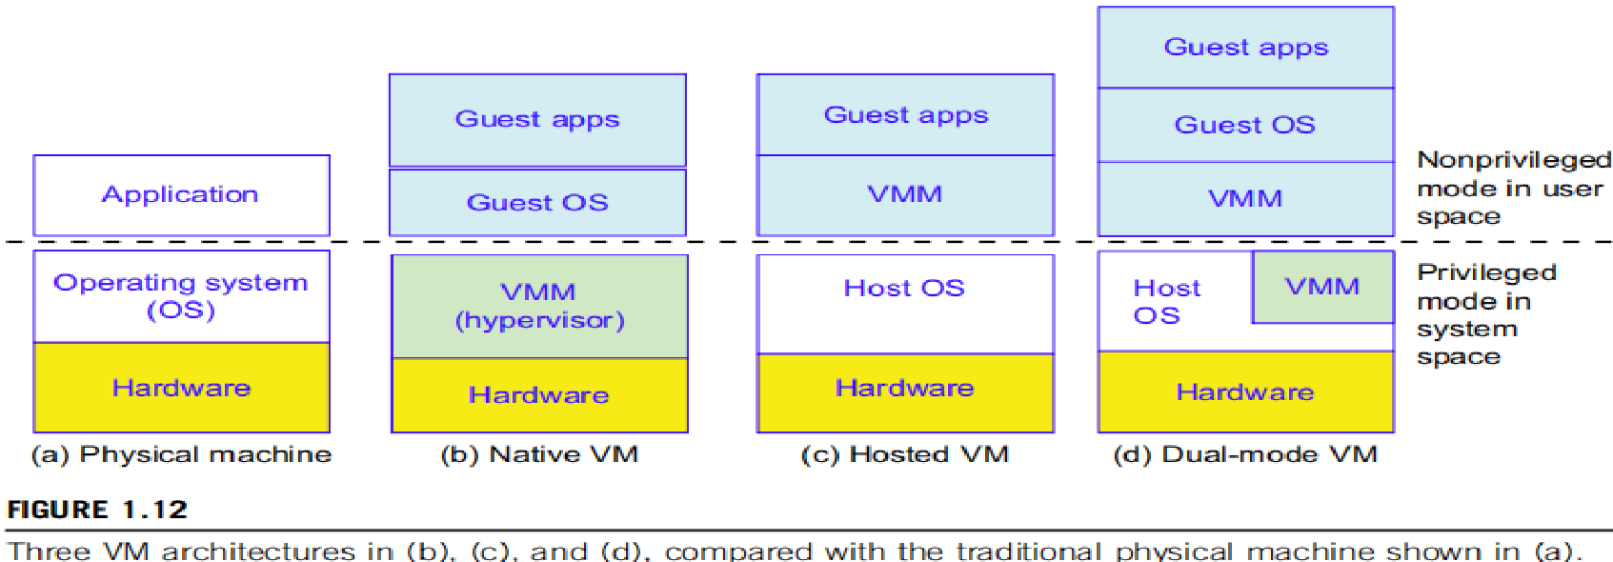
CCS
The VM can also be implemented with a dual mode, as shown in Figure (d).
Part of the VMM runs at the user level and another part runs at the supervisor level.
Multiple VMs can be ported to a given hardware system to support the virtualization process.
The VM approach offers hardware independence of the OS and applications.

Slide 35
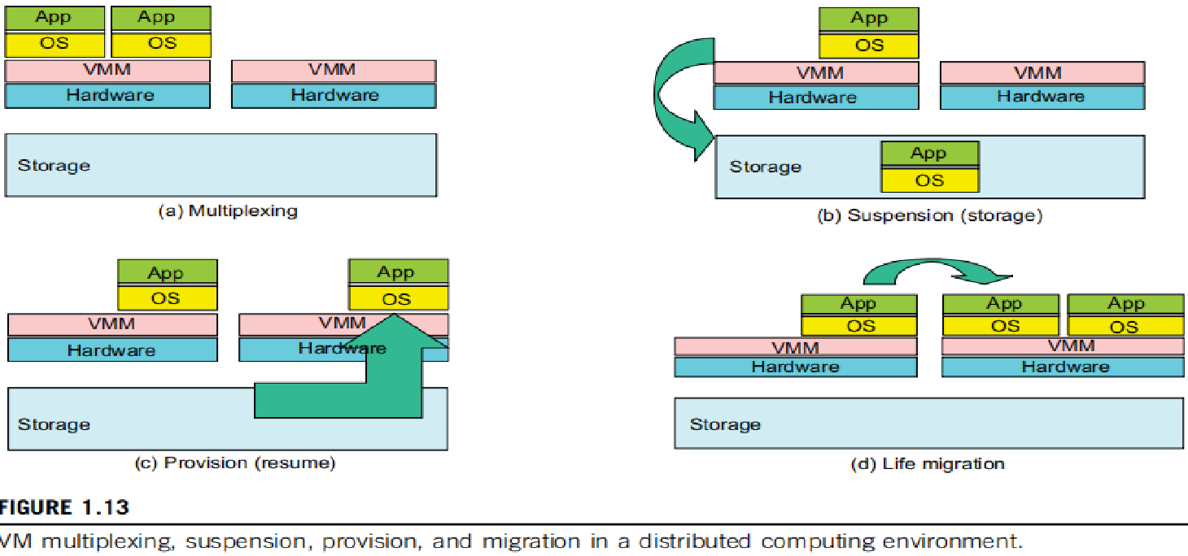
CCS- VM Primitive Operations
Low-level VMM operations are indicated and illustrated in Figure.
First, the VMs can be multiplexed between hardware machines.
Second, a VM can be suspended and stored in stable storage.
Third, a suspended VM can be resumed or provisioned to a new hardware platform.
Finally, a VM can be migrated from one hardware platform to another.

Slide 36

CCS- VM Primitive Operations
These operations enable a VM to be provisioned to any available hardware platform.
They also enable flexibility in porting distributed application executions.
Furthermore, the VM approach will significantly enhance the utilization of server resources.

Slide 37
CCS- Virtual Infrastructures
Physical resources for compute, storage, and networking are mapped to applications embedded in various VMs at the top.
Virtual infrastructure connects resources to distributed applications.
It is a dynamic mapping of system resources to specific applications.
The result is: decreased costs and increased efficiency and responsiveness.
Example: Virtualization for server consolidation and containment.

Slide 38
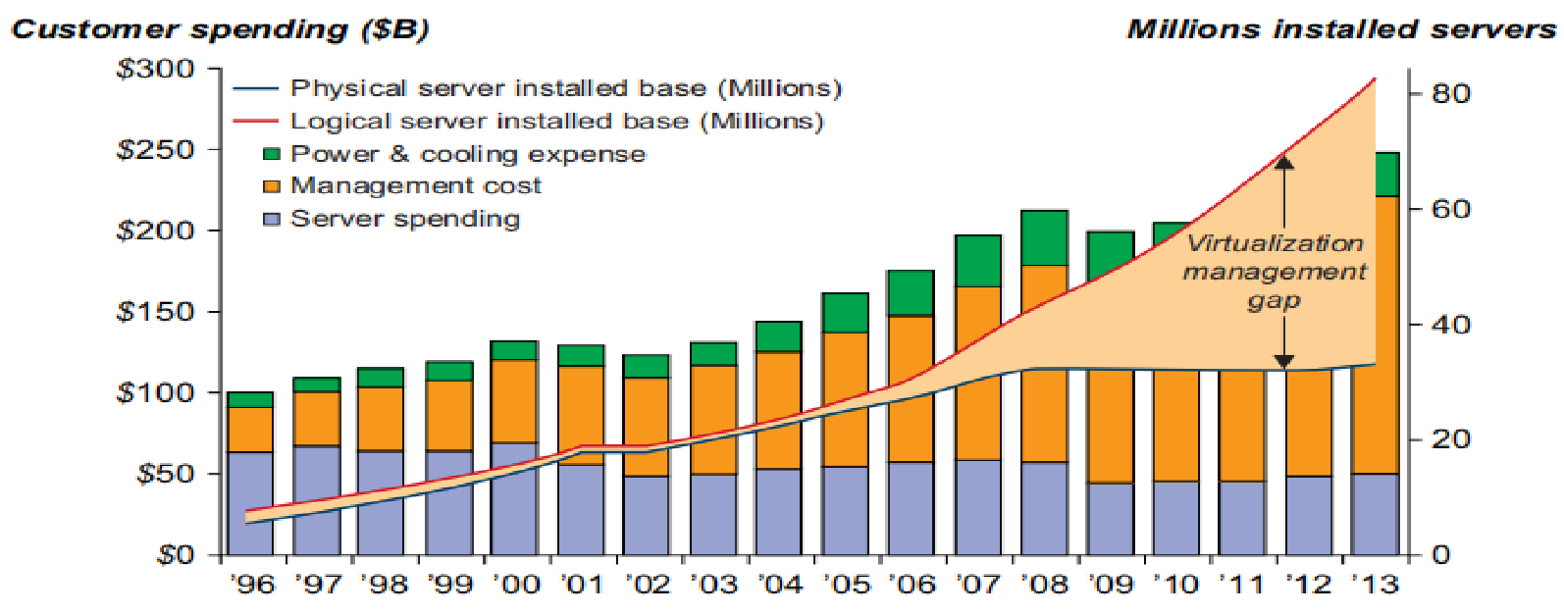
Data Center Virtualization for C C
Cloud architecture is built with commodity hardware and network devices.
Low-cost terabyte disks and Gigabit Ethernet are used to build data centers.
Data center design emphasizes that storage & energy efficiency are more important than speed performance alone.
Figure shows server growth and cost breakdown of data centers over past 15 years.
The cost of utilities, exceeds cost of hardware, after 3 years.
Growth and cost breakdown of data centers over the years.

Slide 39
Data Center Growth and Cost Breakdown
A large data center may be built with 1000s of servers. Smaller data centers are typically built with 1000s of servers.
The cost to build and maintain data center servers has increased over the years.
According to a 2009 IDC report, typically only 30% of data center costs goes toward purchasing IT equipment, 33% is attributed to the chiller, 18% to uninterruptible power supply (UPS), 9% to computer room air conditioning (CRAC), and the remaining 7 % to power distribution, lighting, and transformer costs.
Thus, about 60% of the cost to run a data center is allocated to management and maintenance.
The server purchase cost did not increase much with time. The cost of electricity and cooling did increase from 5% to 14% in 15 years.
High-end switches or routers may be too cost-prohibitive for building data centers.
Thus, using high-bandwidth networks may not fit the economics of cloud computing.

Slide 40

CCS- Convergence of Technologies
Cloud computing is enabled by the convergence of technologies in 4 areas:
(1) hardware virtualization and multi-core chips:
It enables the existence of dynamic configurations in cloud.
(2) utility and grid computing :
They lay necessary foundation for computing clouds.
(3) SOA, Web 2.0, and WS mashups:
They are pushing the cloud another step forward.
(4) atonomic computing and data center automation.
Their achievements in operations contribute to rise of cloud computing.

Slide 41
1.3 System Models for Distributed and Cloud Computing
Distributed and cloud computing systems are built over a large number of autonomous computer nodes.
These node are interconnected by SANs, LANs, or WANs in a hierarchical manner.
LAN switches can easily connect 100’s of machines to form cluster.
A WAN can connect many local clusters to form a very large cluster of clusters.
Massive system with millions of computers connected to edge networks can be built.
They are highly scalable.

Slide 42
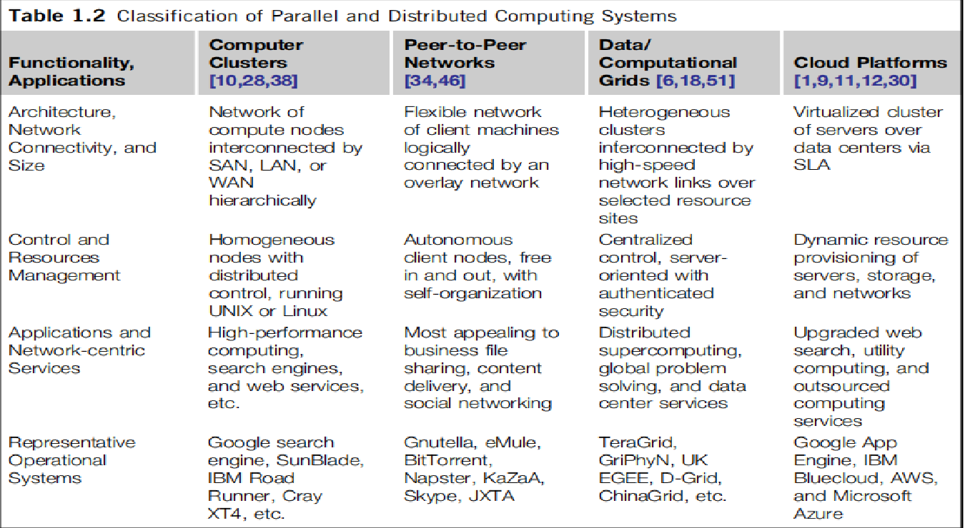
CCS- Massive Systems
Massive systems are classified into 4 groups: clusters, P2P networks, computing grids, & Internet clouds over huge data centers.
These classes may involve 100s, 1000s, or even millions of computers.

Slide 43
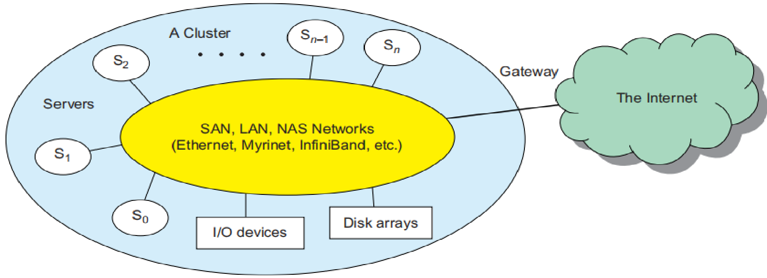
CCS- Clusters of Cooperative Computers
A computing cluster consists of interconnected stand-alone computers which work cooperatively as a single integrated computing resource.
Through hierarchical construction using a SAN, LAN, or WAN, we can build scalable clusters.
The cluster acts as single computer attached to Internet via VPN gateway.
Fig: A cluster of servers interconnected by a low latency high-bandwidth SAN or LAN with shared I/O devices & disk arrays

Slide 44
CCS- Clusters of Cooperative Computers
The gateway IP address locates the cluster.
The system image of a computer is decided by the way the OS manages the shared resources.
Most clusters have multiple system images as a result of having many autonomous nodes under different OS control.
An ideal cluster merges multiple system images into a single-system image (SSI).
Cluster designers desire a cluster OS or middleware to support SSI at various levels.
An SSI is an illusion and makes the cluster appear like a single machine to the user.
A cluster with multiple system images is nothing but a collection of independent computers.

Slide 45
Hardware, Software, and Middleware Support
Special middleware supports are needed to create SSI or high availability (HA).
Both sequential and parallel applications can run on the cluster.
Many SSI features are expensive or difficult to achieve at various cluster levels.
Instead of achieving SSI, many clusters are loosely coupled machines.
Using virtualization, one can build many virtual clusters dynamically, upon user demand.

Slide 46
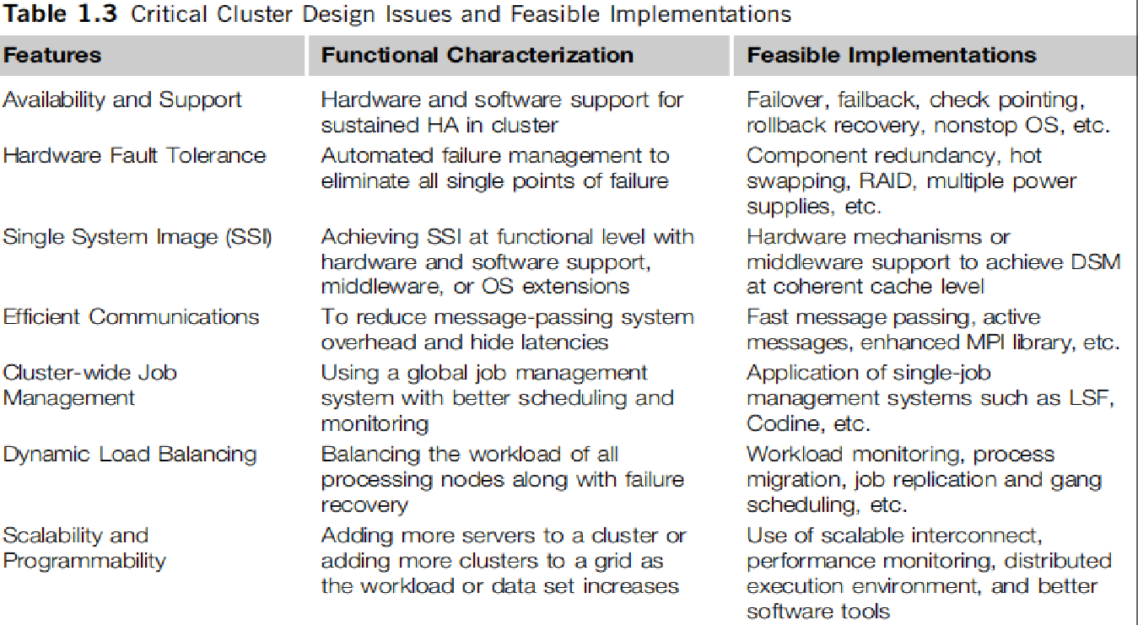
CCS - Cluster Design Issues
The cluster benefits are:
scalable performance, efficient message passing, high system availability, seamless fault tolerance, and cluster-wide job management

Slide 47
CCS- Grid Computing Infrastructures
Grid computing allows interaction among applications running on distant computers simultaneously.
Computing grid offers an infrastructure that couples computers, software, instruments, people and sensors together.
Enterprises or organizations see grids as integrated computing resources.
They can also be viewed as virtual platforms to support virtual organizations.
The computers used in a grid are primarily:
workstations, servers, clusters, and supercomputers.
Personal computers, laptops, and PDAs can be used as access devices to a grid system.

Slide 48
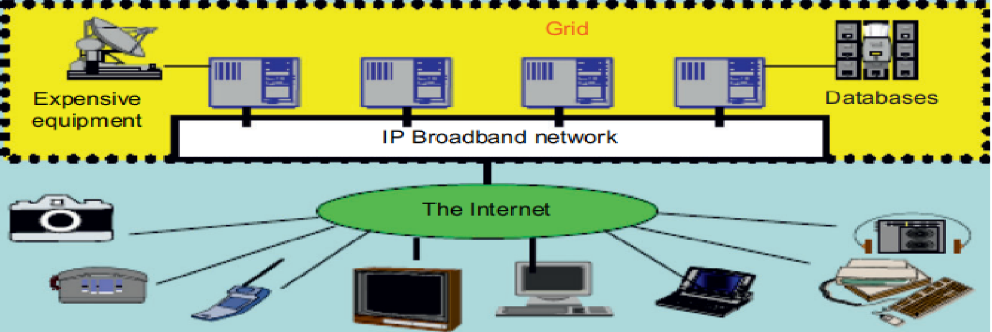
CCS
Computational grid are built over multiple resource sites owned by different organizations.
Grid is built across various IP broadband networks(LANs & WANs) already used by organizations.
It is presented to users as an integrated resource pool as shown in the upper half of the figure.

Slide 49
CCS
At the server end: grid is a network. At the client end: its wired or wireless terminal devices.
It integrates computing, communication, contents, and transactions as, rented services.
Enterprises and consumers form the user base, it then defines usage trends and service characteristics.

Slide 50
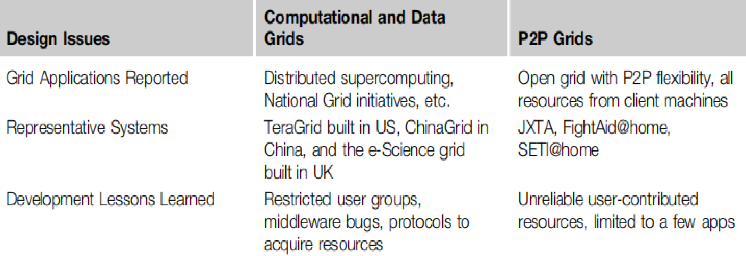
CCS- Grid technology
Grid technology requires, new distributed computing models, software support, network protocols, and hardware infrastructures.
New grid service providers (GSPs) and grid applications have emerged rapidly.
Grid systems are classified in essentially 2 categories:
Computational or data grids and
P2P grids.

Slide 51
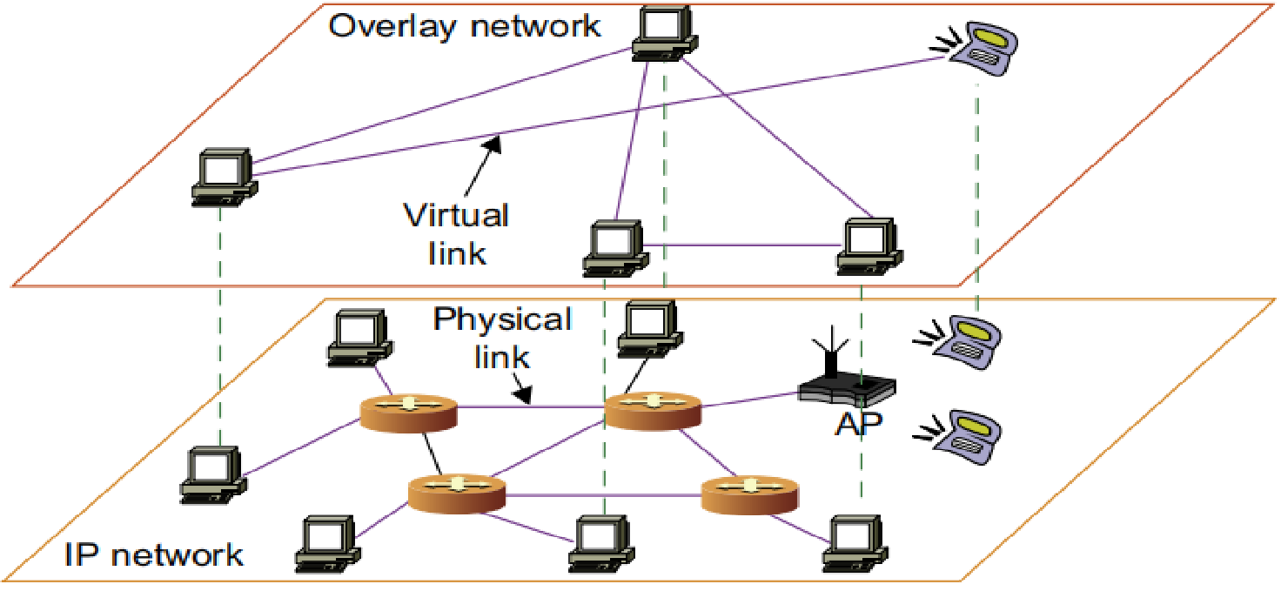
Peer-to-Peer Network
A P2P network is client-oriented instead of server-oriented.
Architecture of a P2P network at 2 abstraction levels.
Initially, the peers are totally unrelated.
Participating peers form the physical network(ad hoc network) at any time.
Due to free membership the P2P network varies in size & topology.

Slide 52

CCS- Peer-to-Peer Network
Based on communication or file-sharing needs, peer IDs form an overlay network at logical level.
This overlay is a virtual network formed by mapping each physical machine with its ID, logically, as shown in Figure.
When a new peer joins the system, its peer ID is added as a node in the overlay network.

Slide 53
CCS- Peer-to-Peer Network
When an existing peer leaves the system, its peer ID is removed from the overlay network automatically.
There are 2 types of overlay networks: unstructured and structured.
An unstructured overlay network is characterized by a random graph. There is no fixed route to send messages or files among the nodes.
Structured overlay networks follow certain connectivity topology and rules for inserting and removing nodes (peer IDs).

Slide 54
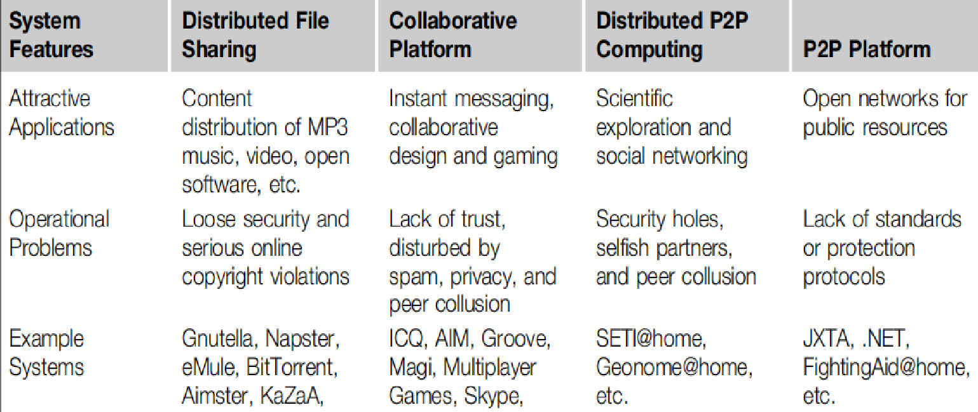
CCS- Peer-to-Peer Network
Based on application, P2P networks are classified into 4 groups.
P2P computing faces 3 types of heterogeneity problems in hardware, software, and network requirements.
Incompatibility exists between software and OS; and different network connections & protocols make it too complex.

Slide 55
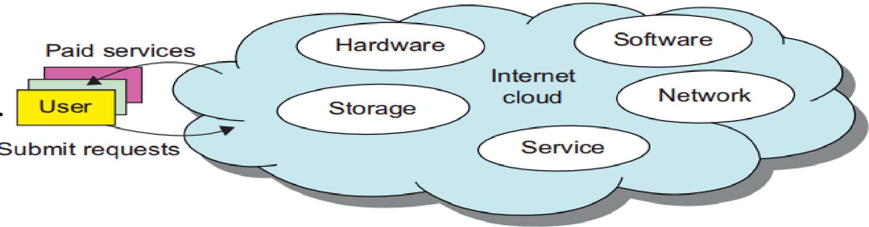
Cloud Computing over the Internet
A cloud is a pool of virtualized computer resources.
Cloud computing applies a virtualized platform, by provisioning hardware, software, and data sets dynamically.
Its low cost and simplicity, benefit both users and providers.
The cloud ecosystem must be designed to be secure, trustworthy, and dependable.
Some users think of the cloud as a centralized resource pool and others consider it to be a server cluster.

Slide 56
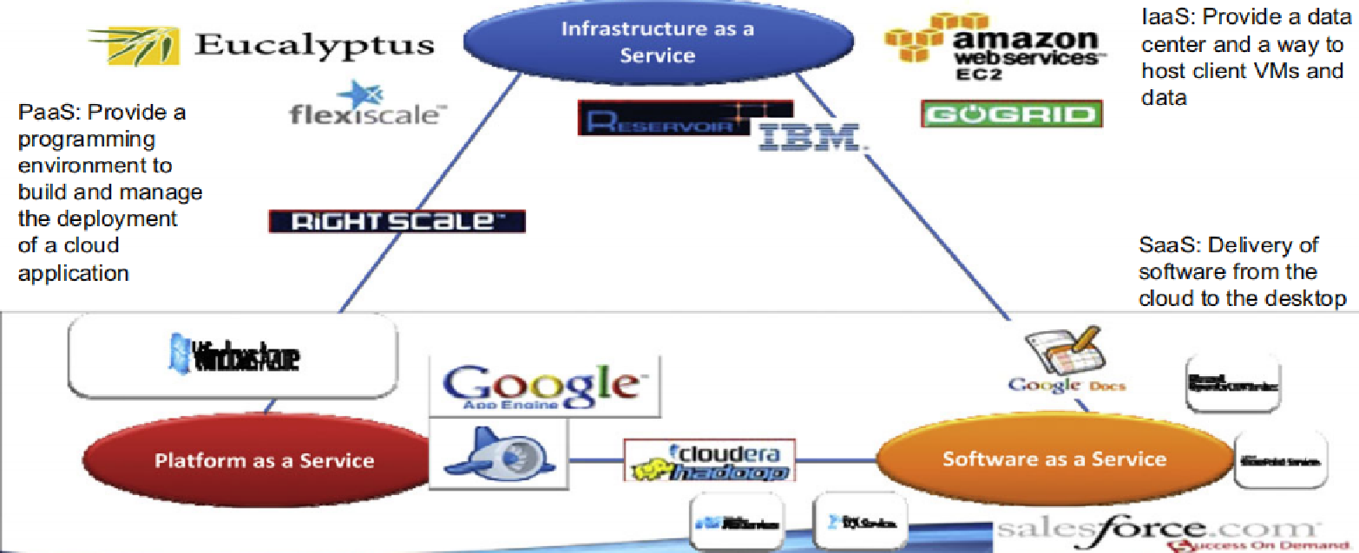
CCS- The Cloud Landscape
Usually, distributed computing system is owned and operated by autonomous administrative domain (e.g., a research laboratory or company).
These systems have encountered several bottlenecks:
constant system maintenance, poor utilization, and increasing hardware/software upgrade costs.
Cloud computing resolves these problems.
Figure: cloud landscape & major cloud players, based on 3 service models.

Slide 57
CCS- The Cloud Landscape
Infrastructure as a Service (IaaS)
This model puts infrastructures( servers, storage, networks & data center) demanded by users.
The user can deploy & run on multiple VMs running guest OSes.
The user does not manage or control underlying infrastructure,
They can specify when to request and release needed resources.
Platform as a Service (PaaS)
This model enables the user to deploy user-built applications onto a virtualized cloud platform.
PaaS includes middleware, databases, development tools, and some runtime support such as Web 2.0 and Java.
The platform includes both hardware and software integrated with specific programming interfaces.
The provider supplies the API and software tools.
The user is freed from managing the cloud infrastructure.

Slide 58
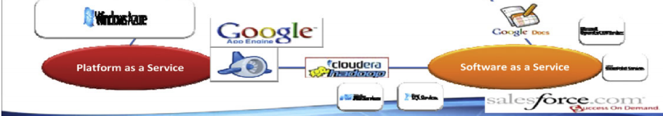
CCS- The Cloud Landscape
Software as a Service (SaaS)
This refers to browser-initiated application software over 1000s of paid cloud customers.
The SaaS model applies to:
business processes,
industry applications,
consumer relationship management (CRM),
enterprise resources planning (ERP),
human resources (HR), and
collaborative applications.
On the customer side, there is no upfront investment in servers or software licensing.
On the provider side, costs are rather low, compared with conventional hosting of user applications.

Slide 59
CCS- The Cloud Landscape
Internet clouds offer 4 deployment modes: private, public, managed, and hybrid.
These modes demand different levels of security implications.
8 reasons to adapt cloud for upgraded Internet applications and web services:
1. Desired location in areas with protected space & higher energy efficiency.
2. Sharing of peak-load capacity among a large pool of users, improving overall utilization.
3. Separation of infrastructure maintenance duties from domain-specific application development.
4. Significant reduction in cloud computing cost, compared with traditional computing paradigms.
5. Cloud computing programming & application development.
6. Service & data discovery & content/service distribution.
7. Privacy, security, copyright, & reliability issues.
8. Service agreements, business models, & pricing policies.

Slide 60
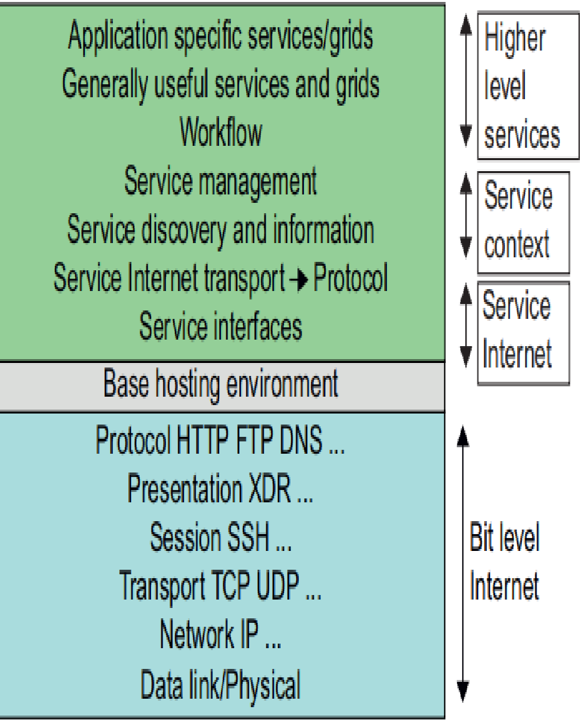

1.4 Software Environments for Distributed Systems & Clouds
Figure shows layered architecture for distributed entities used in web services and grid systems.
In grids/web services, an entity is, a service, a Java object, and a CORBA distributed object.
These architectures build on traditional 7 Open Systems Interconnection layers.
On top of this we have a base software environment, which could be .NET or Apache Axis for web services or JVM for Java.
On top of this base environment one would build a higher level environment reflecting the special features of the distributed computing environment.
This starts with entity interfaces and inter-entity communication, which rebuild the top 4 OSI layers but at the entity and not the bit level.

Slide 61
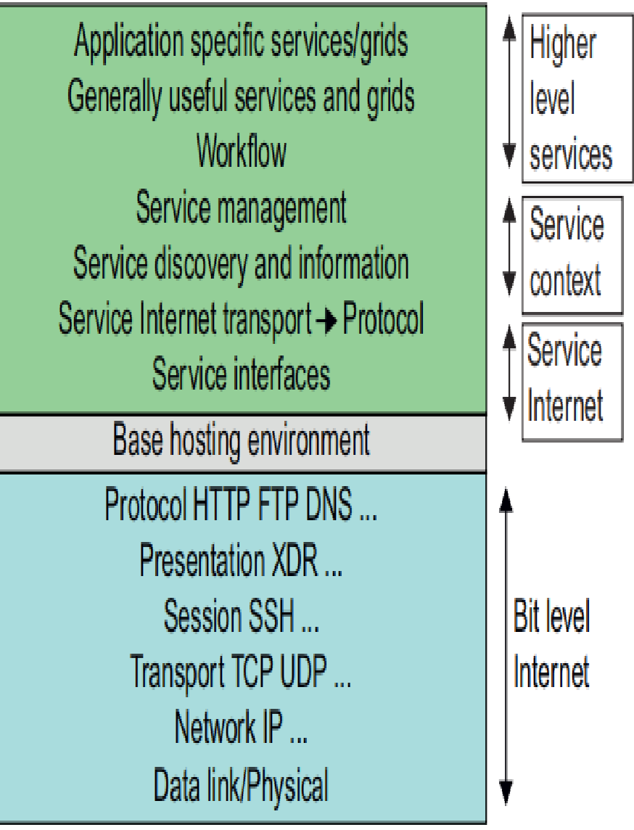
1.4 Software Environments for Distributed Systems & Clouds
The entity interfaces correspond to Web Services Description Language, Java method, and CORBA interface definition language specifications.
These interfaces are linked with customized, high-level communication systems.
These systems support features including particular message patterns, fault recovery, and specialized routing.
Often, these systems are built on message-oriented middleware infrastructure.

Slide 62
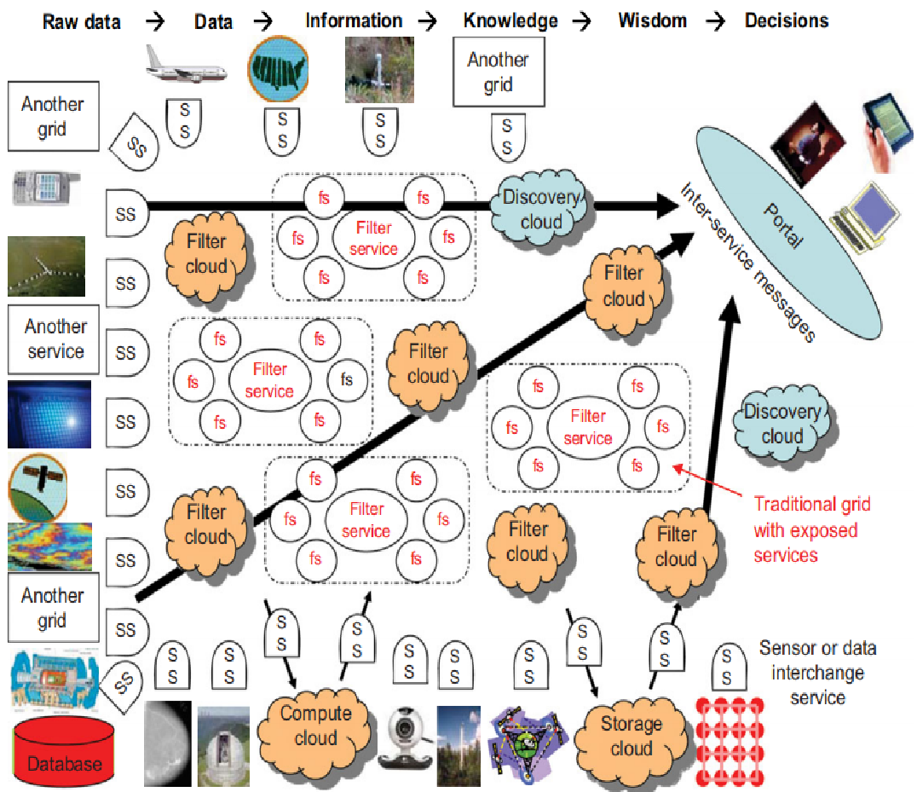
CCS- The Evolution of SOA
--Service-oriented architecture (SOA) has evolved over the years.
-- SOA applies to building grids, clouds, grids of clouds, clouds of grids, clouds of clouds, and systems of systems in general.
-- A large number of sensors provide data-collection services, denoted in figure as SS (sensor service).
-- A sensor can be a ZigBee device, a Bluetooth device, a WiFi access point, a personal computer, or a wireless phone.

Slide 63
Evolution of SOA(Service-oriented architecture)
Raw data is collected by sensor services.
All SS devices interact with: computers, many forms of grids, databases, compute cloud, storage cloud, filter cloud, discovery cloud, and so on.
Filter services (fs) are used to eliminate unwanted raw data, in order to respond to specific requests from web, grid, or web services.
A collection of filter services forms a filter cloud.
SOA aims to search for, or sort out, useful data from massive amounts of raw data items.
Processing this data will generate useful information, and subsequently, knowledge.
Most distributed systems require a web interface or portal.
Inter-service messages converge at the portal, which is accessed by all users.

Slide 64
CCS- Grids versus Clouds
A grid system applies static resources, while a cloud emphasizes elastic resources.
The differences between grids and clouds are: in dynamic resource allocation based on virtualization and autonomic computing.
One can build a grid out of multiple clouds.
This type of grid can do a better job than a pure cloud.

Slide 65

Trends toward Distributed Operating Systems
To promote resource sharing and fast communication among node machines, it is best to have a distributed OS.
A distributed OS is crucial for upgrading:
performance,
efficiency, and
flexibility of distributed applications.
There are 3 approaches for distributing resource management functions in a distributed computer system.
1st approach is to build a network OS over a large number of heterogeneous OS platforms.
2nd approach is to develop middleware to offer a limited degree of resource sharing.
3rd approach is to develop a truly distributed OS to achieve higher use or system transparency.

Slide 66
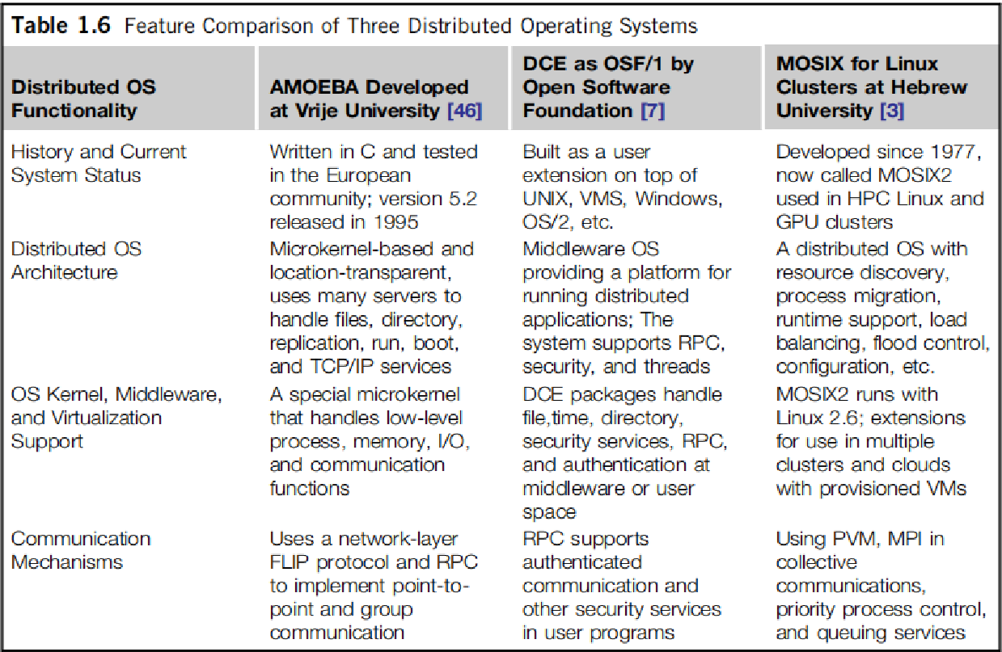
CCS
.

Slide 67
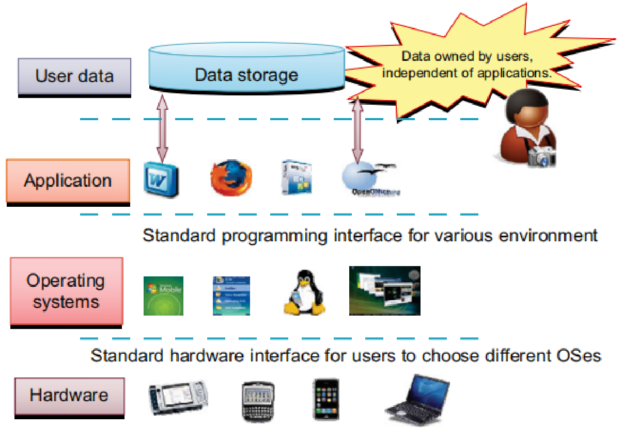

Transparency in Programming Environments
The user data, applications, OS, and hardware are separated into 4 levels.
Data is owned by users, independent of the applications.
OS provides clear interfaces, standard programming interfaces, or system calls to application programmers.
In future users will be able to choose different OSes to use on top of hardware devices they prefer.
Users can enable cloud applications as SaaS, to separate data from specific application programs .
They can switch among different services.
Fig: A transparent computing environment that separates the user data, application, OS, and hardware in time

Slide 68

Parallel & Distributed Programming Models
MPI is the most popular programming model for message-passing systems.
Google’s MapReduce and BigTable are for and space – an ideal model for cloud computing effective use of resources from Internet clouds and data centers.
Service clouds demand extending Hadoop, EC2, and S3 to facilitate distributed computing over distributed storage systems.

Slide 69
1.5 Performance, Security and Energy Efficiency
Performance metrics are needed to measure various distributed systems.
In a distributed system, System throughput is often measured in:
MIPS(Million Instructions Per Second),
Tflops (tera floating-point operations per second), or
TPS (transactions per second).
Other measures include job response time and network latency.
Other performance-related metrics include:
QoS for Internet and web services;
System availability and dependability; and
Security resilience for system defense against network attacks.

Slide 70

CCS- Dimensions of Scalability
The following dimensions of scalability are characterized in parallel and distributed systems:
Size scalability This refers to achieving higher performance or more functionality by increasing machine size.
Software scalability This refers to upgrades in OS or compilers, adding mathematical and engineering libraries, porting new application software, and installing more user-friendly programming environments.
Application scalability This refers to, matching, problem size scalability with machine size scalability. Problem size affects the size of the data set or the workload increase.
Technology scalability This refers to a system that can adapt to changes in building technologies, such as the component and networking technologies

Slide 71
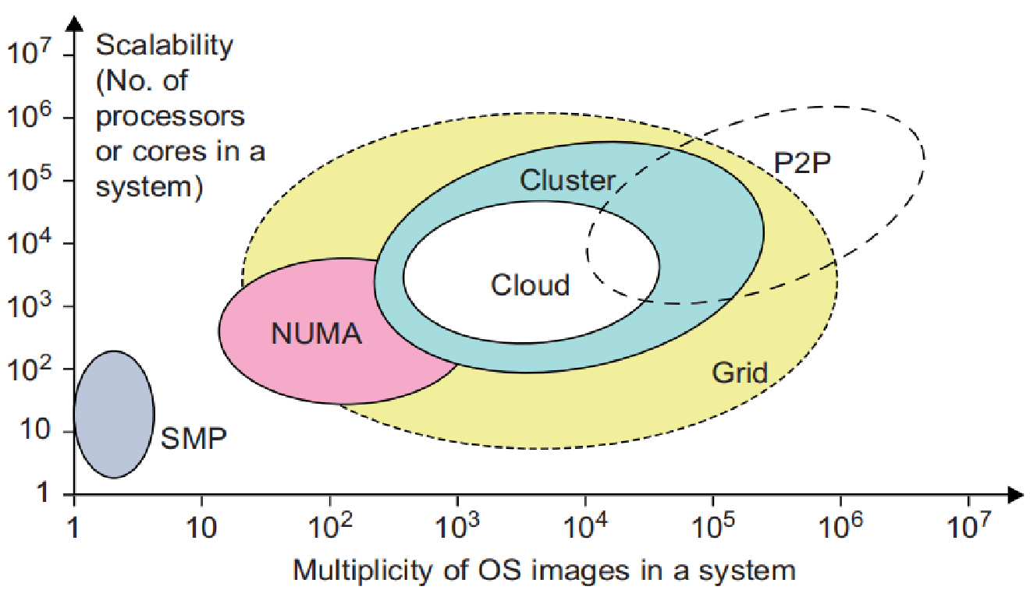

CCS- Scalability versus OS Image Count
Scalable performance implies that:
system can achieve higher speed by adding more processors or servers, enlarging physical node’s memory size, extending disk capacity, or adding more I/O channels.
OS image is counted by number of independent OS images observed in a cluster, grid, P2P network, or cloud.
SMP(symmetric multiprocessor) & NUMA(nonuniform memory access) are included in comparison.
SMP server has a SSI.
NUMA are often made out of SMP nodes with distributed, shared memory.
The cluster nodes can be either SMP servers or high-end loosely coupled machines.
Fig. scalable performance is estimated against the multiplicity of OS images in distributed systems deployed up to 2010

Slide 72
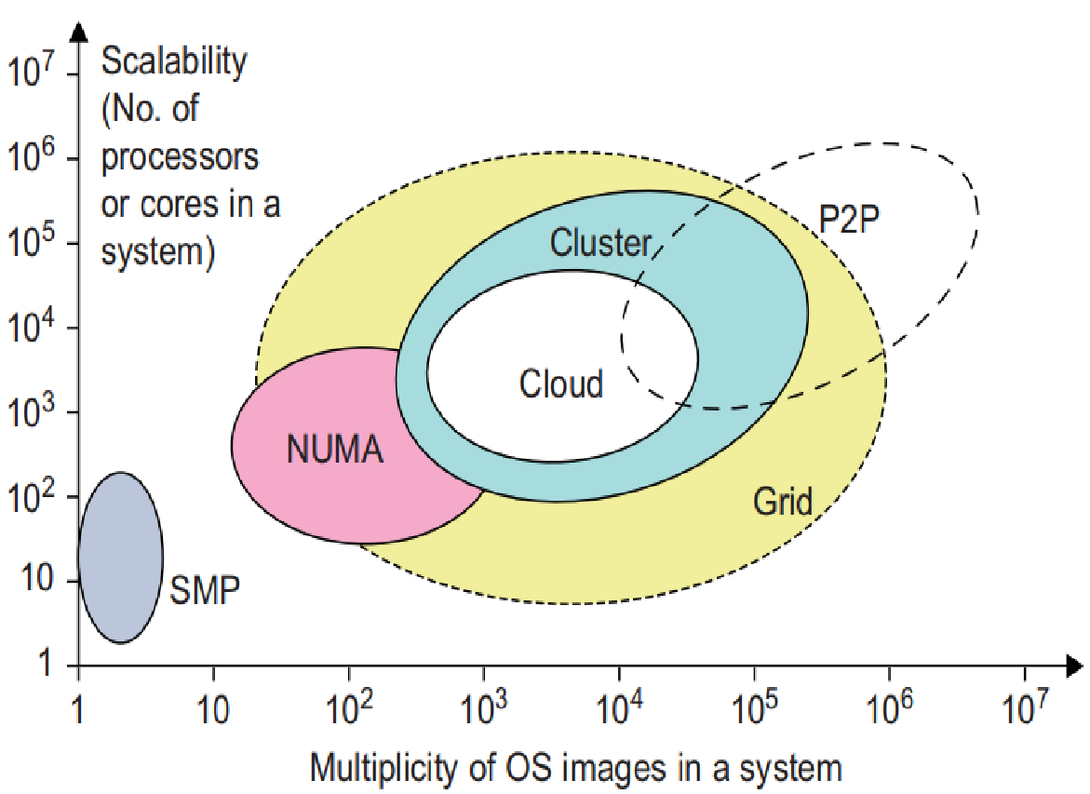
CCS- Scalability versus OS Image Count
The number of OS images in a cluster is based on the cluster nodes concurrently in use.
The cloud could be a virtualized cluster.
The grid node could be a server cluster, or a mainframe, or a supercomputer, or an MPP.
A P2P network can easily scale to millions of independent peer nodes, essentially desktop machines.
Fig: System scalability versus multiplicity of OS images based on 2010 technology.

Slide 73

CCS- Amdahl’s Law
Consider the execution of a program on a uniprocessor workstation with a total execution time of T minutes.
Let’s say: the program has been partitioned for parallel execution on a cluster of many processing nodes.
Assume fraction α, of code, must be executed sequentially (sequential bottleneck).
Therefore, (1 − α) of the code can be compiled parallelly by n processors.
Total execution time of the program is calculated by α T + (1 − α)T/n,
first term(α T) is sequential execution time on a single processor and
second term is parallel execution time on n processing nodes.
System or communication overhead, I/O time or exception handling time is also not included in the speedup analysis.

Slide 74
CCS- Amdahl’s Law
It states that: speedup factor of using n-processor system over the use of a single processor is expressed by:
Speedup =S= T/ [αT +(1− α)T/n] = 1/[α + (1 −α)/n]
Maximum speedup of n is achieved only if sequential bottleneck α is reduced to zero or code is fully parallelizable with α = 0.
As the cluster becomes large,i.e., n → ∞, S approaches 1/α, an upper bound on speedup S.
Sequential bottleneck is the portion of code that cannot be parallelized even if one uses hundreds of processors.
Inference: make the sequential bottleneck as small as possible.

Slide 75
CCS- Problem with Fixed Workload
In Amdahl’s law, we have assumed the same amount of workload for both sequential and parallel execution of the program with a fixed problem size or data set. This was called fixed-workload speedup.
To execute a fixed workload on n processors, parallel processing may lead to a system efficiency as follows:
E = S/n = 1/[αn +1 −α]
S - Speedup
α - Sequential bottleneck
The system efficiency is low, when cluster size is very large.

Slide 76
CCS- Gustafson’s Law
To achieve higher efficiency when using a large cluster, scale the problem size to match the cluster capability.
This leads to following speedup law referred as scaled-workload speedup
Let W be workload in a given program.
When using an n-processor system, user scales workload to
W′ = αW + (1 − α)nW.
Only parallelizable portion(1 − α) of workload is scaled n times in second term.
This scaled workload W′ is the sequential execution time on a single processor.
The parallel execution time of a scaled workload W′ on n processors is defined as :
S′ = W′/W = [αW + (1− α)nW]/W = α+ (1 −α)n
This speedup is known as Gustafson’s law.

Slide 77
CCS- Gustafson’s Law
By fixing the parallel execution time at level W, the following efficiency expression is obtained:
E′ =S′/n= α/n+(1− α)
One should apply Amdahl’s law and Gustafson’s law under different workload conditions.
For a fixed workload, users should apply Amdahl’s law.
To solve scaled problems, users should apply Gustafson’s law.

Slide 78
Fault Tolerance and System Availability
HA (high availability) is desired in all clusters, grids, P2P networks, and cloud systems.
A system is highly available if it has a long mean time to failure (MTTF) and a short mean time to repair (MTTR).
System availability is formally defined as follows:
System Availability = MTTF/(MTTF + MTTR)
Any failure that will pull down the operation of the entire system is called a single point of failure.
The rule of thumb is to design a dependable computing system with no single point of failure.

Slide 79
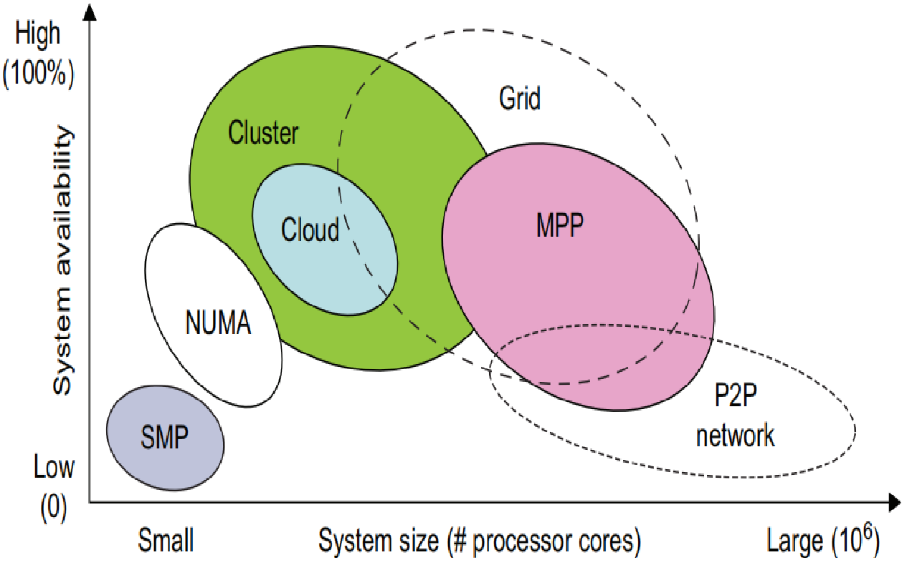

CCS- Estimated System Availability
In Figure, effects on system availability are estimated by scaling system size in terms of number of processor cores in the system.
As a distributed system increases in size, availability decreases due to a higher chance of failure and a difficulty in isolating the failures.
Both (Symmetric Multiprocessing) SMP and MPP are vulnerable with centralized resources under one OS.
NUMA machines have improved in availability due to the use of multiple OSes.
Most clusters are designed to have HA with failover capability.
Grids have higher availability due to the isolation of faults.
A P2P network operates independently with low availability.
Fig:Estimated system availability by system size of common configurations in 2010.

Slide 80
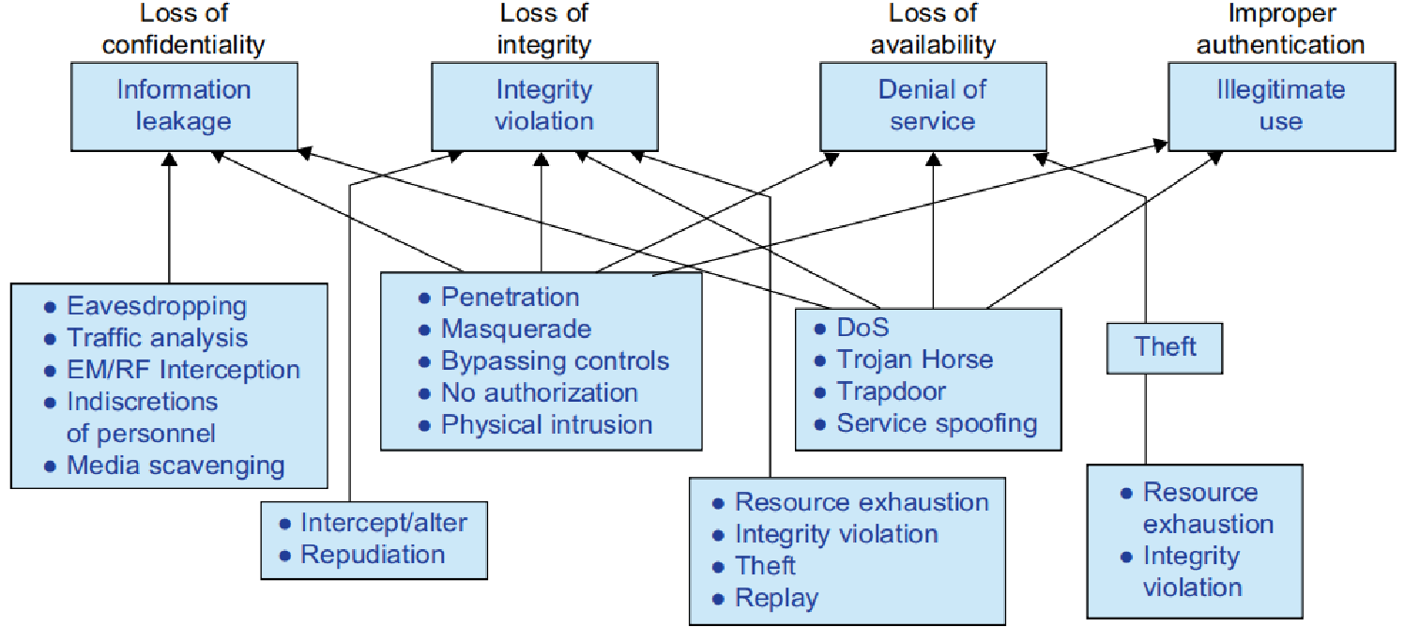

Network Threats and Data Integrity
Network viruses have threatened many users in widespread attacks.
Figure: summarizes various attack types and their potential damage to users.
Information leaks lead to a loss of confidentiality.
Loss of data integrity may be caused by user alteration, Trojan horses, and service spoofing attacks.
A denial of service results in a loss of system operation & Internet connections.

Slide 81
CCS
Security Responsibilities:
3 security requirements are often considered:
confidentiality,
integrity, and
availability for most Internet service providers and cloud users.
Copyright Protection:
One can develop a proactive content poisoning scheme to stop colluders and pirates from alleged copyright infringements in P2P file sharing.
Pirates are detected in a timely manner with identity-based signatures and time stamped tokens.

Slide 82
CCS
System Defense Technologies:
3 generations of network defense technologies have appeared in the past.
In 1st generation: tools were designed to prevent or avoid intrusions
The 2nd generation: detected intrusions in a timely manner to exercise remedial actions.
The 3rd generation: provides more intelligent responses to intrusions.
Data Protection Infrastructure:
Security infrastructure is required to safeguard web and cloud services.
At user level: one needs to perform trust negotiation and reputation aggregation over all users.
At application end: we need to establish security precautions in worm containment and intrusion detection and distributed DoS (DDoS) attacks

Slide 83
CCS
Energy Efficiency in Distributed Computing
Primary performance goals in conventional parallel and distributed computing systems are high performance and high throughput.
Energy consumption in parallel and distributed computing systems raises various monetary, environmental, and system performance issues.
In addition to power cost, cooling is another issue that must be addressed due to negative effects of high temperature on electronic components

Slide 84
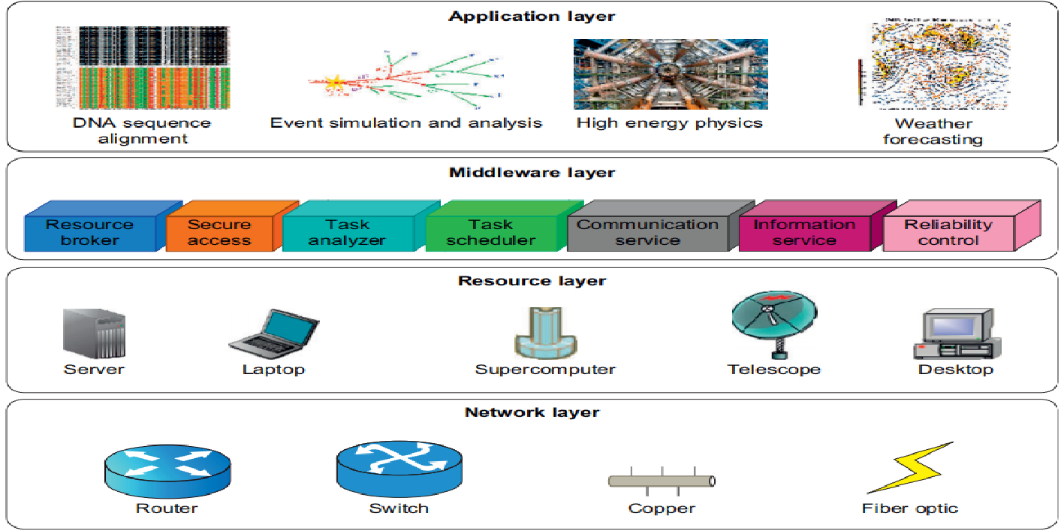
CCS- Reducing Energy in Active Servers
It is necessary to decrease energy consumption in distributed systems with negligible influence on their performance.
Power management issues can be categorized into 4 operational layers: the application layer, middleware layer, resource layer, and network layer.

Slide 85
CCS
Application Layer
By introducing energy-aware applications, the challenge is to design sophisticated multilevel and multi-domain energy management applications without hurting performance.
An application’s energy consumption depends on number of instructions needed to execute the application & number of transactions with storage unit (memory).
Middleware Layer
This layer provides resource broker, communication service, task analyzer, task scheduler, security access, reliability control, & information service capabilities.
It is also responsible for applying energy-efficient techniques, particularly in task scheduling.
Distributed computing systems necessitate a new cost function covering both makespan and energy consumption.

Slide 86
CCS
Resource Layer
It consists of a wide range of resources including computing nodes and storage units.
This layer interacts with hardware devices and OS;
It is responsible for controlling all distributed resources in distributed computing systems.
Several mechanisms have been developed for more efficient power management of hardware & OS.
Dynamic power management (DPM) and dynamic voltage-frequency scaling (DVFS) are 2 popular methods incorporated into recent computer hardware systems.
Network Layer
Routing and transferring packets and enabling network services to the resource layer are the main responsibility.
2 major challenges in designing energy-efficient networks are:
The models should represent networks comprehensively as they should give understanding of interactions among time, space, and energy.
New, energy-efficient routing algorithms need to be developed. New, energy-efficient protocols should be developed against network attacks.

Slide 87
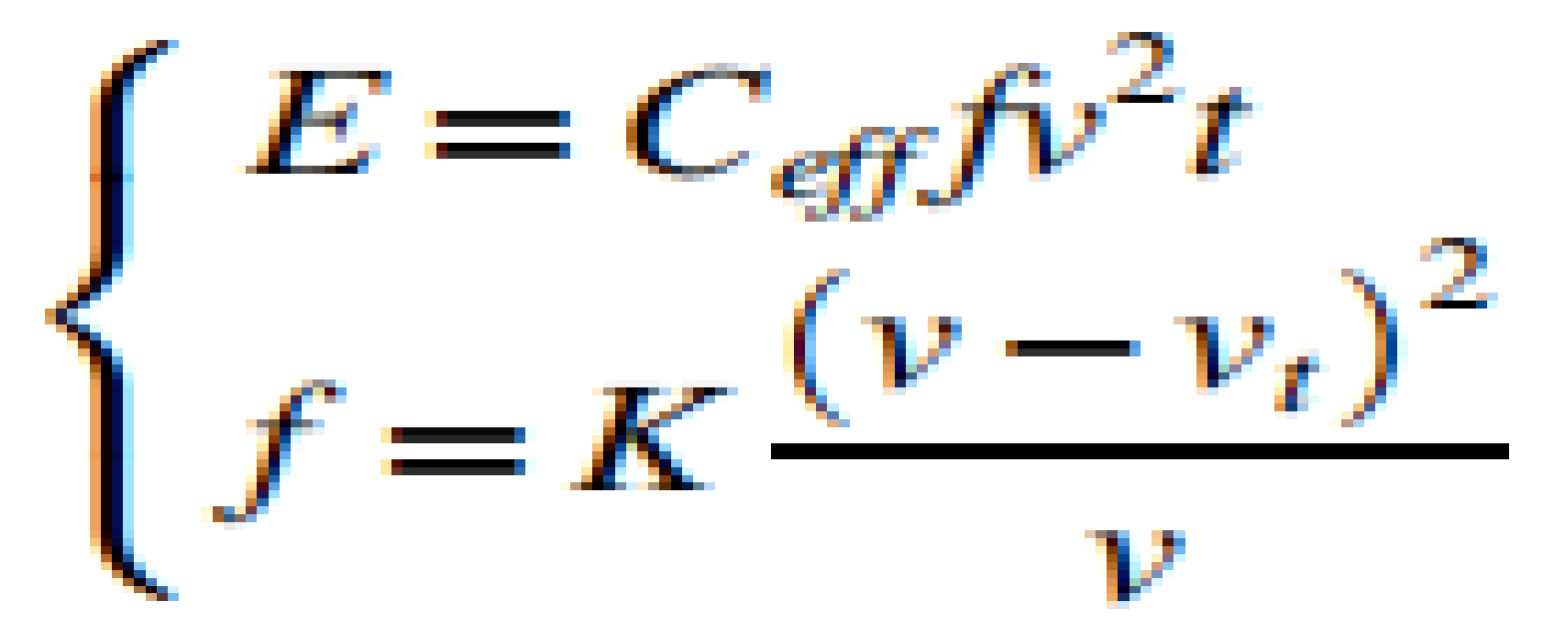
CCS
DVFS Method for Energy Efficiency
DVFS method enables exploitation of slack time (idle time) typically incurred by intertask relationship.
Slack time associated is utilized to execute task in a lower voltage frequency.
The relationship between energy and voltage frequency in CMOS circuits is related by:
where v, Ceff, K, and vt are the voltage, circuit switching capacity, a technology dependent factor, and threshold voltage, respectively,
t --> execution time of the task under clock frequency f.
By reducing voltage and frequency, the device’s energy consumption can also be reduced.

Slide 88
THANK YOU

